Slide 1

System Overview
Model 3600 OPTOMIZER® FCS Sheeter Inspection™ Technology
Bruce T. Dobbie

Slide 2

Mission Statement
R.K.B. OPTO-ELECTRONICS, INC. is a designer and manufacturer of high speed machine vision, web inspection, process control and quality assurance and related technologies. We are the most diverse supplier and are committed to the industry and our customers that depend on us to ensure that quality is maintained at the highest possible level. We are dedicated to increasing customer satisfaction, continuously improving our products and services, and providing opportunities for our employees to achieve their maximum potential.

Slide 3
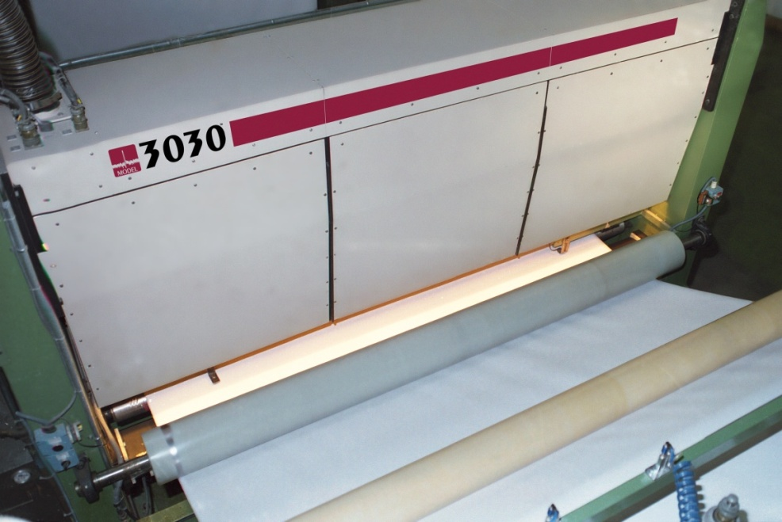
Model 3600 OPTOMIZER® FCS Sheeter Inspection™ Technology
FOR MORE INFO...
http://www.splicedetector.net/splicedetector_products/fcs_sheeter-wis.html
http://www.splicedetector.com/splicedetector_products/fcs_sheeter-wis.html

Slide 4

Technology

Slide 5
Overview of Benefits
The Model 3600 OPTOMIZER® FCS Sheeter Inspection™ Technology is designed to monitor webs of material in sheeting processes. The Model 3600 OPTOMIZER® spans the entire web width and can be setup for either hole/spot type defect detection, coating streak detection or all types of defects. Upon detection of a defect, the signal is transferred to the sheeter process reject control system to operate the diversion gate to allow either the whole section to be rejected or specific cut size sheets only with defects to be rejected prior to stacking. It solves product quality issues at point of cut prior to packaging or subsequent conversion processes. The Model 3600 OPTOMIZER® is intended for implementation on any sheeter/cutter.

Slide 6
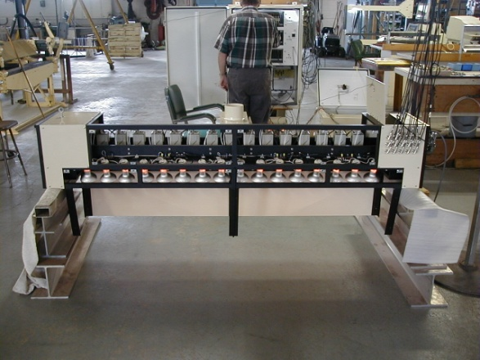
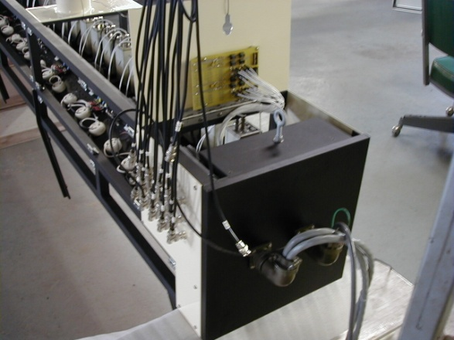
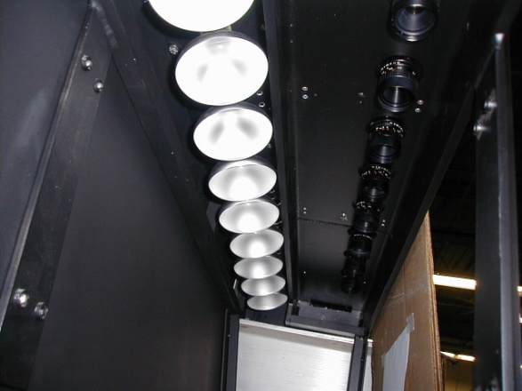
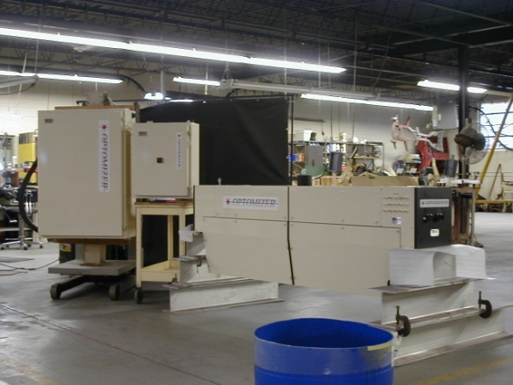
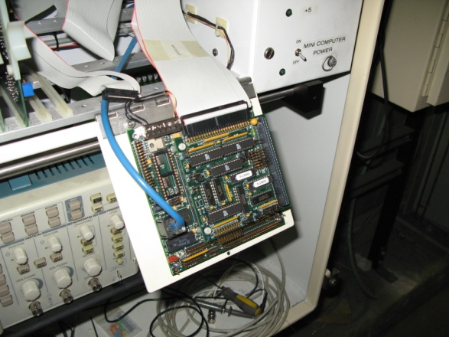
Features and Benefits
Every unit is handcrafted to specific standards which facilitates inter-changeability and performance.

Slide 7
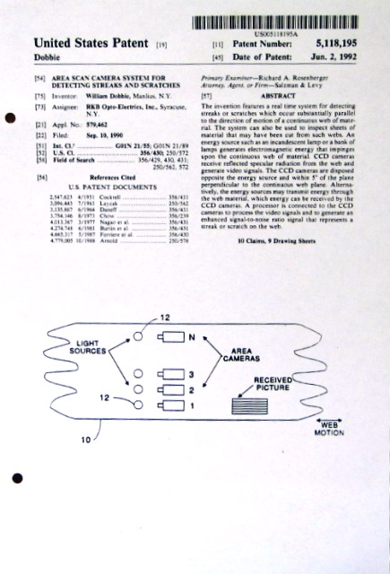
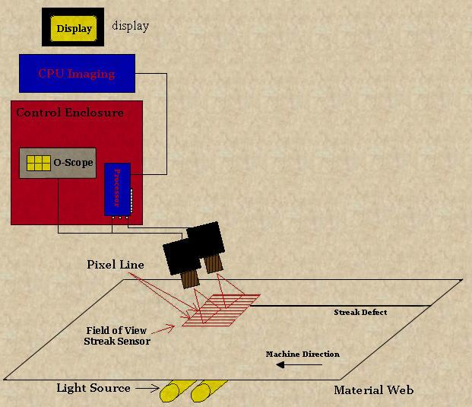
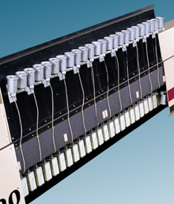
Features and Benefits
The Model 3600 FCS Sheeter Inspection™ is patented technology and implemented the most efficient filtering techniques for successful detection of all defects including coating streaks as small as 0.001” wide at any process speed.

Slide 8
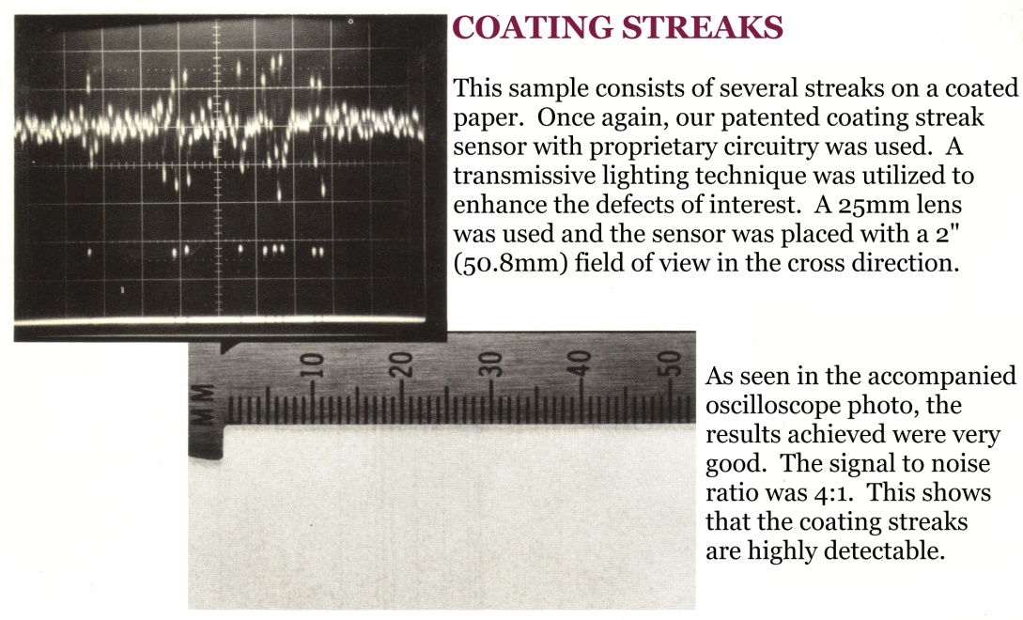
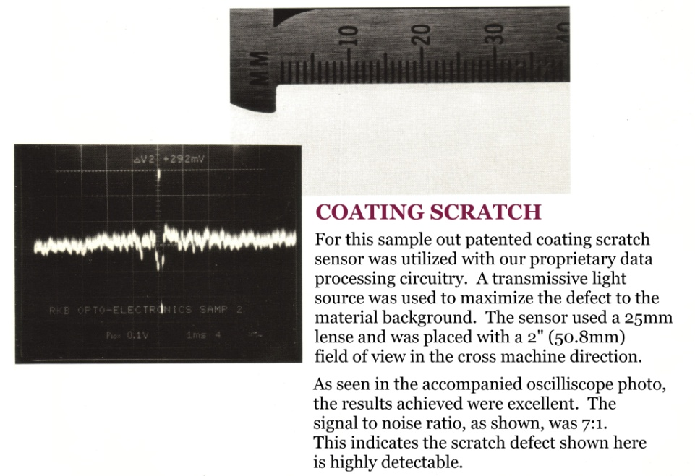
Features and Benefits
Monitors any coated web material where coating streak or scratch defects are required to be detected and/or corrected.

Slide 9
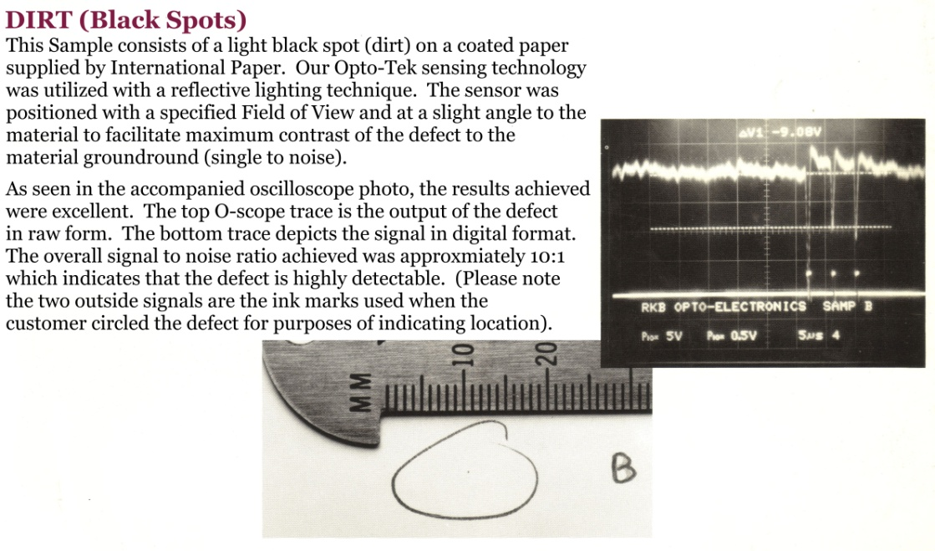
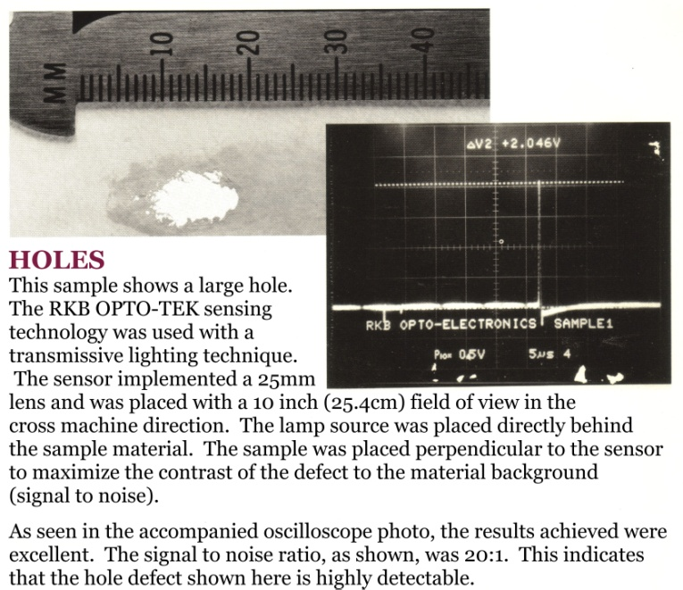
Features and Benefits
Monitors any coated or non-coated web material where holes, oil, dirt, scale, fish eyes, gels, bubbles, ink, or other autonomous defects are required to be detected, classified, logged or culled out.

Slide 10
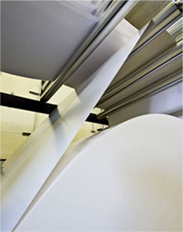
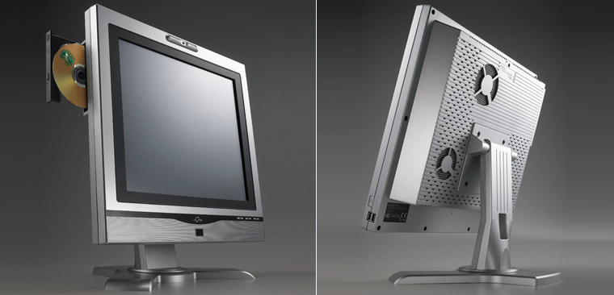
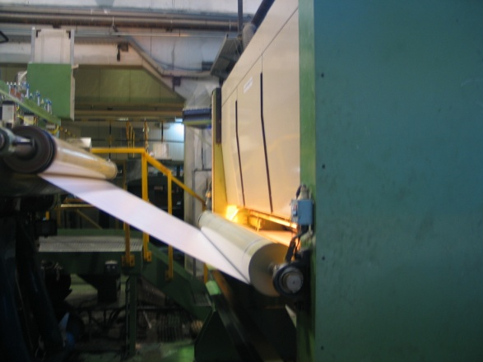
Features and Benefits
Monitor single to multiple webs of material by modular based inspection stations integrated seamlessly into one integrated control station.

Slide 11
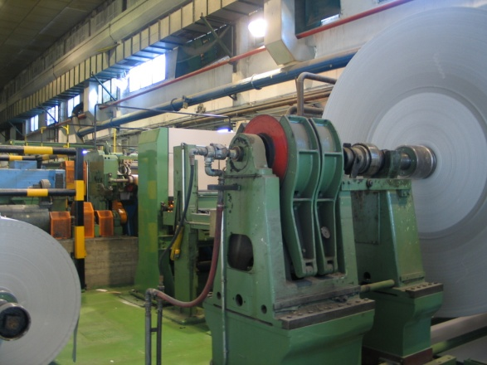
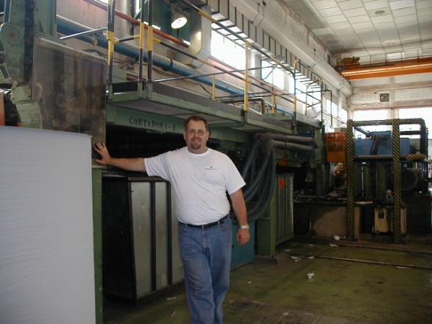
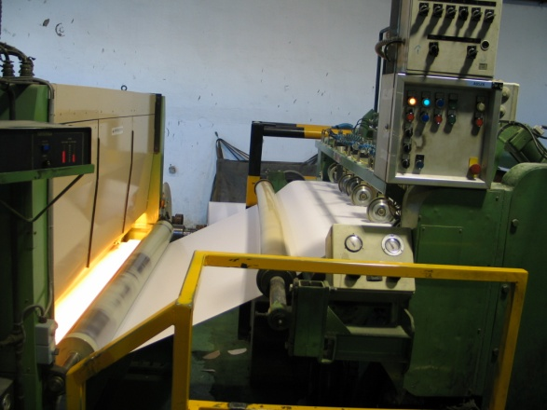
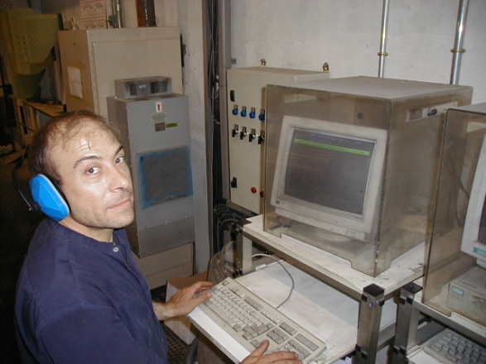
Features and Benefits
Unaffected by material basis weight changes, color or process speed.

Slide 12
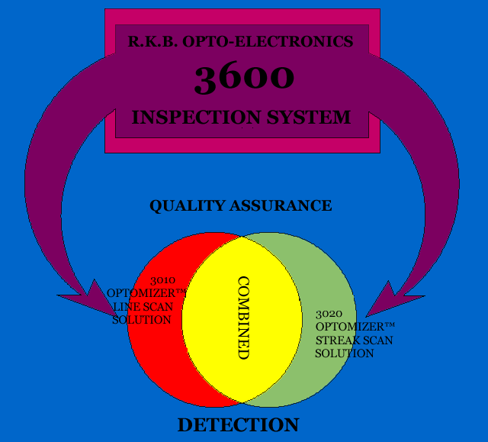
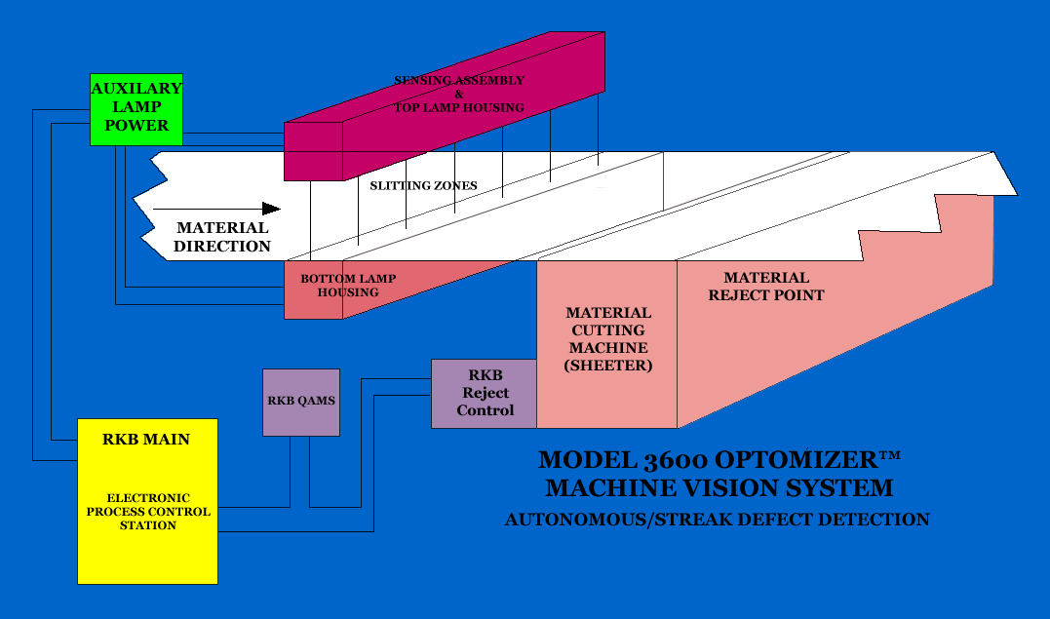
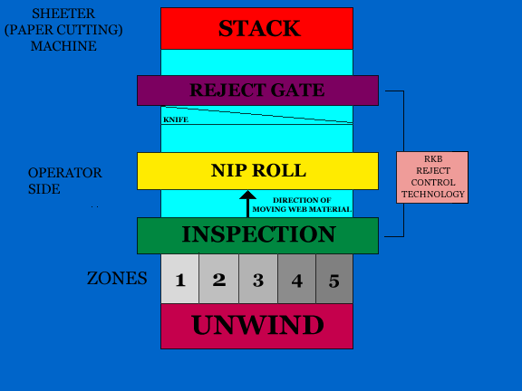
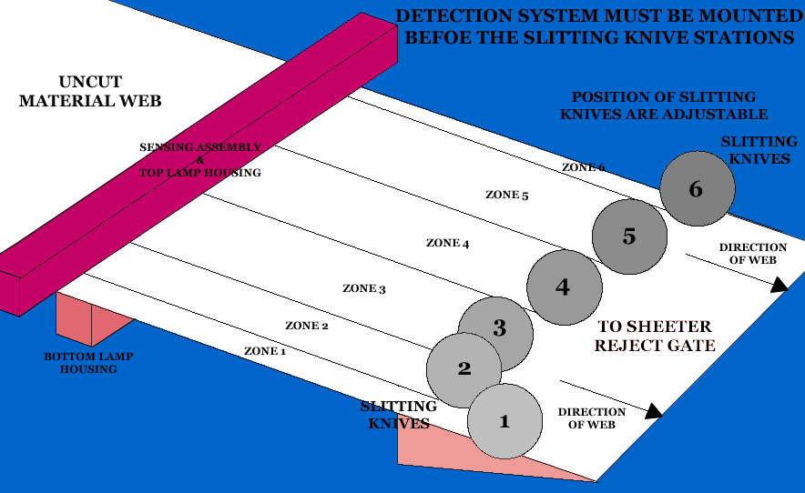
Features and Benefits
The Model 3600 FCS Sheeter Inspection™ uses state-of-the-art and patented electronic design circuitry, components, filtering and processing techniques unequaled in the industry. Depending on your process run, defect signals as small as 50millivolt DC are identified, classified, logged and rejected.

Slide 13
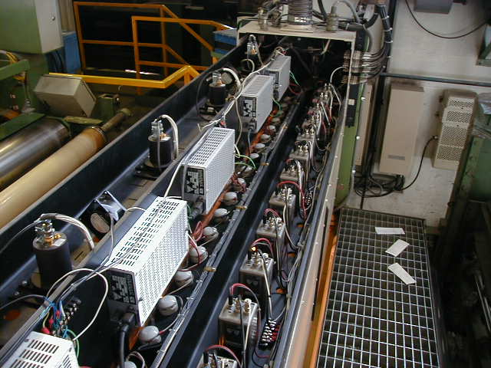
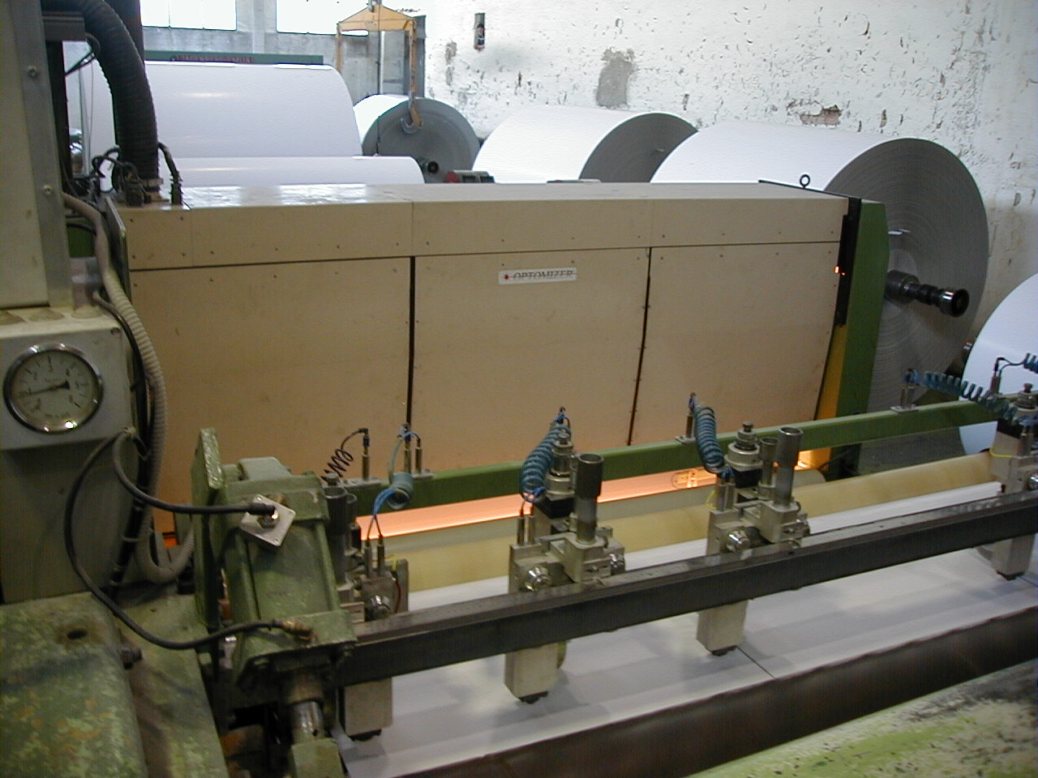
Features and Benefits
State-of-the-Art Proprietary Sensing Platform.

Slide 14
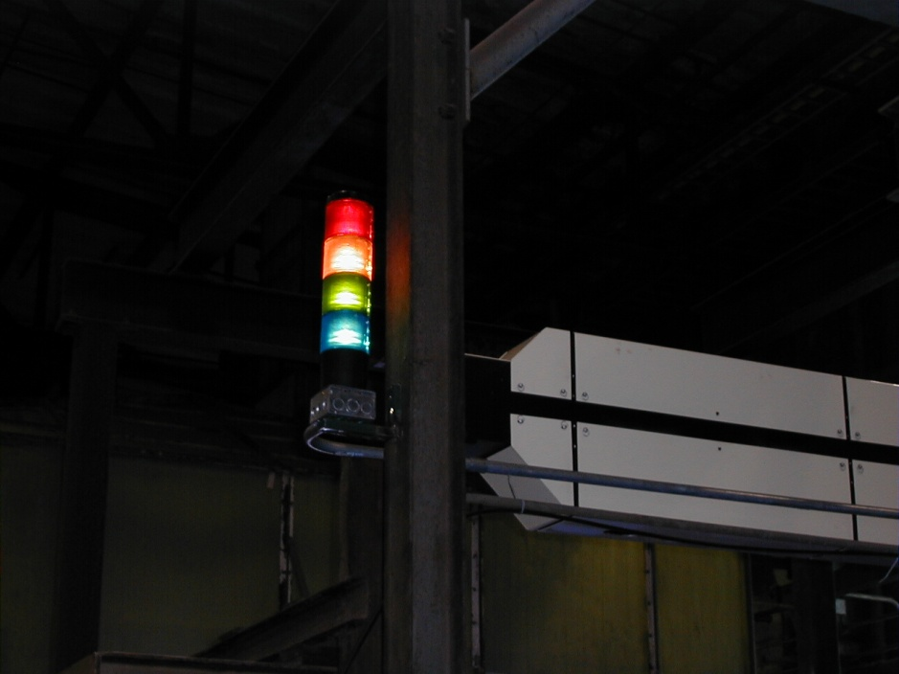
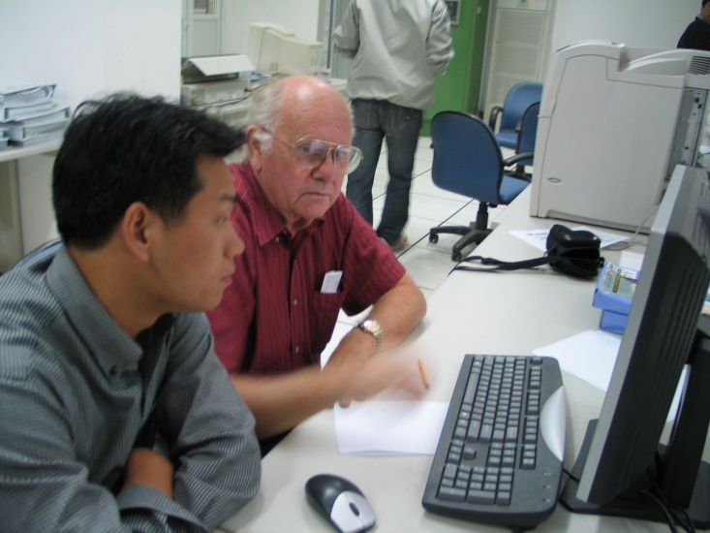
Features and Benefits
Highly visible indicator lamps and audio alarms provide immediate alert to operational staff of critical defect detection and rejection. The customized software program provides user friendly outputs you can actually use too monitor overall quality assurance per run.

Slide 15
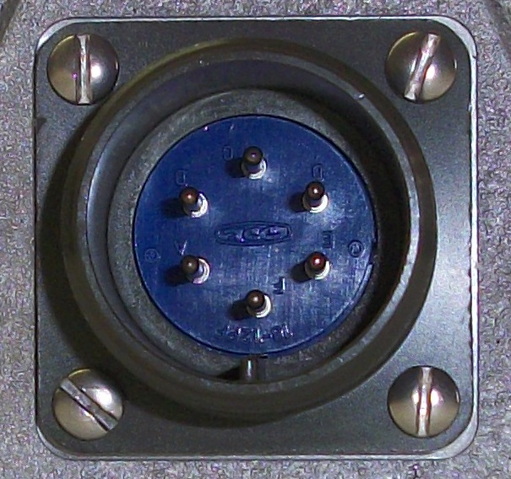
Features and Benefits
Military type connections ensure solid electrical specifications are maintained and environmental protection is achieved.

Slide 16
Features and Benefits
Meets quality initiative and ISO requirements.
Detection 24/7 without the need for operational intervention.
Eliminate the need for manual inspections.
CE, CCC and RoHS Compliant

Slide 17
Applications
Sheeters

Slide 18

Detection Results
The result is the detection of all types of defects commonly found in material manufacturing processes such as this coating skip.

Slide 19

Detection Results
The result is the detection of all types of defects commonly found in material manufacturing processes such as this coating streak in paperboard

Slide 20
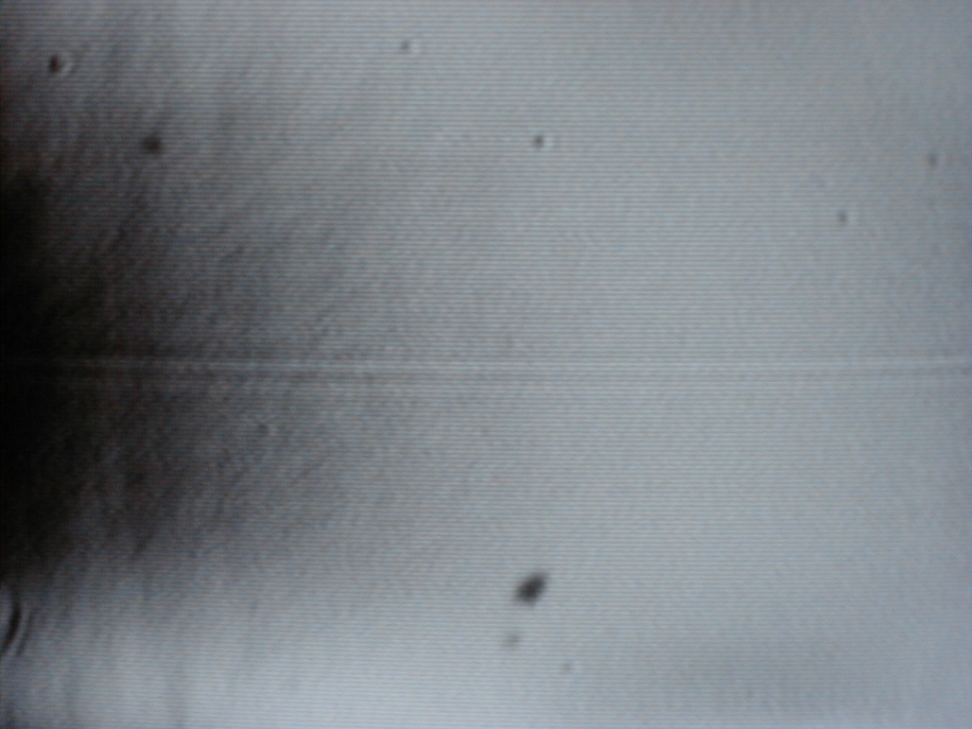
Detection Results
The result is the detection of all types of defects commonly found in material manufacturing processes such as this coating streak in magnetic media.

Slide 21
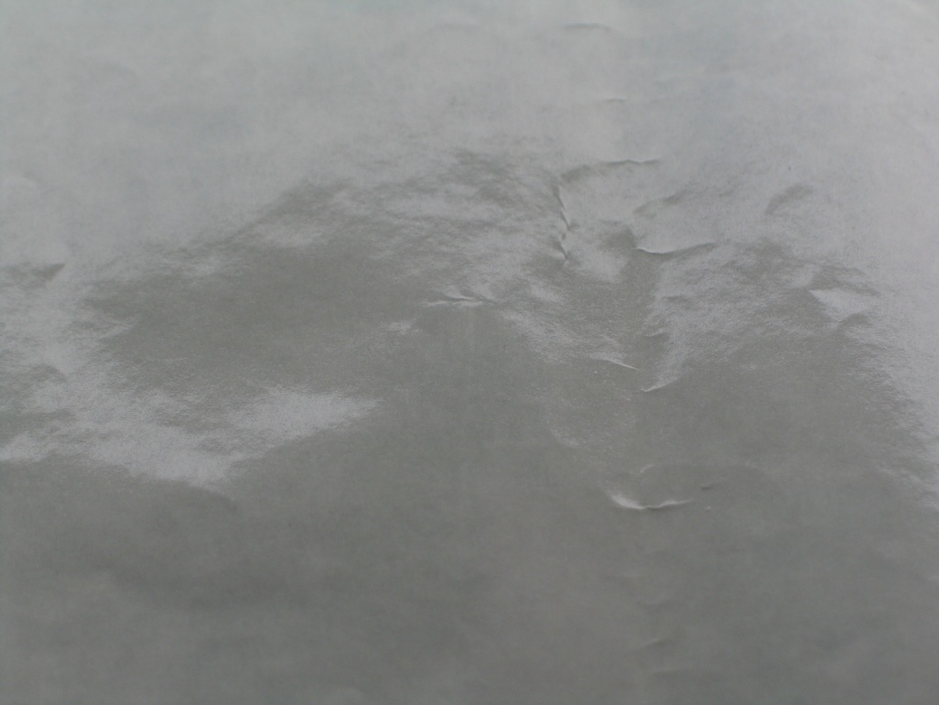
Detection Results
The result is the detection of all types of defects commonly found in material manufacturing processes such as this coating streak in silicone release.

Slide 22

Detection Results
The result is the detection of all types of defects commonly found in material manufacturing processes such as this coating streak in coated brown board.

Slide 23
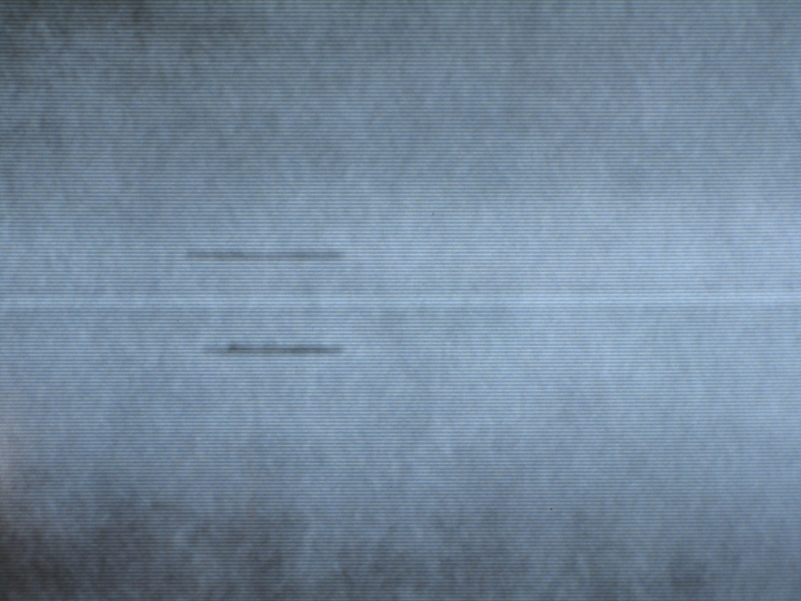
Detection Results
The result is the detection of all types of defects commonly found in material manufacturing processes such as this coating streak in off machine coated paper.

Slide 24
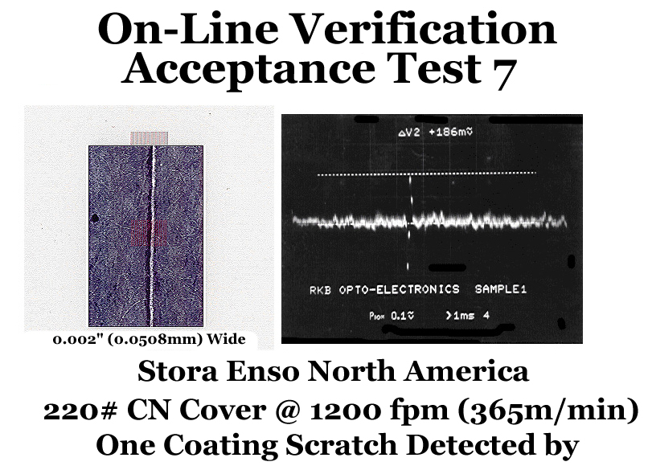
Detection Results
The result is the detection of all types of defects commonly found in material manufacturing processes such as this coating scratch in on machine coated paper.

Slide 25
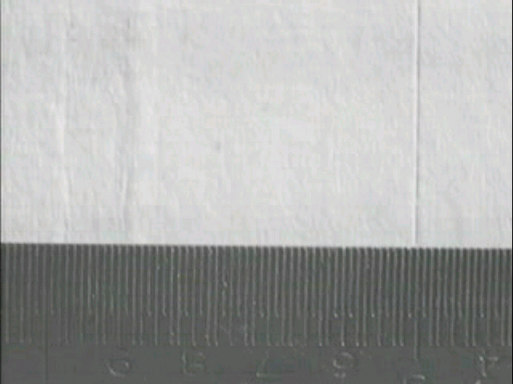
Detection Results
The result is the detection of all types of defects commonly found in material manufacturing processes such as this coating scratch and coating streak in coated grey board.

Slide 26
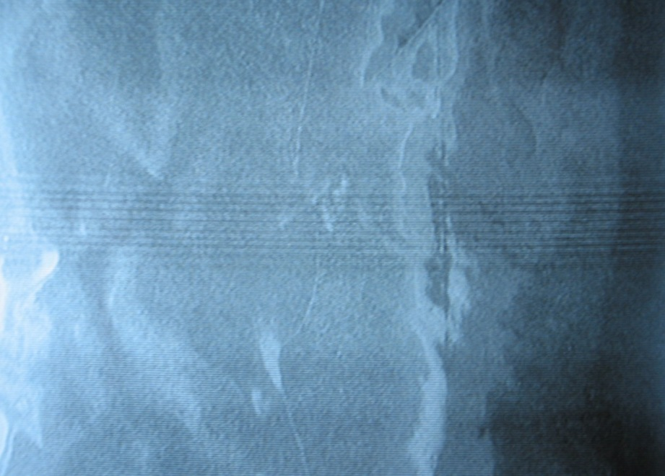
Detection Results
The result is the detection of all types of defects commonly found in material manufacturing processes such as these coating streaks in metalized aluminum packaging.

Slide 27
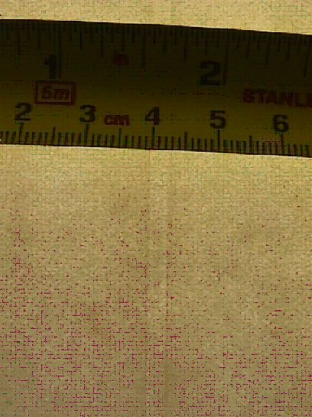
Detection Results
The result is the detection of all types of defects commonly found in material manufacturing processes such as this coating scratch in off machine coated paper.

Slide 28
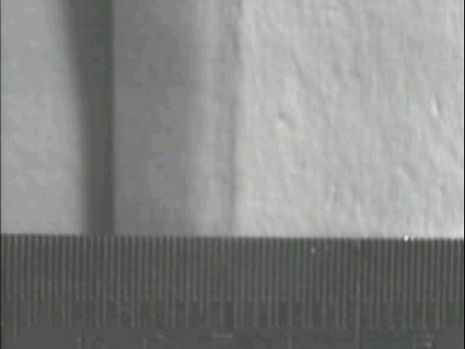
Detection Results
The result is the detection of all types of defects commonly found in material manufacturing processes such as this “Bad Edge” in coated grey board.

Slide 29
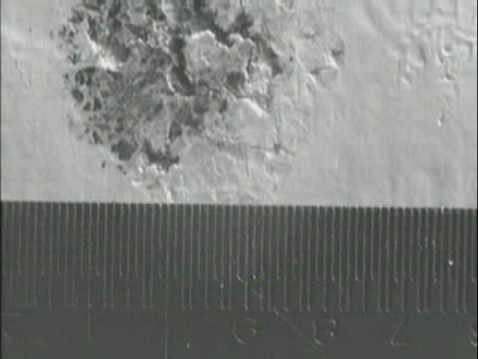
Detection Results
The result is the detection of all types of defects commonly found in material manufacturing processes such as this Coating Void in coated white board.

Slide 30
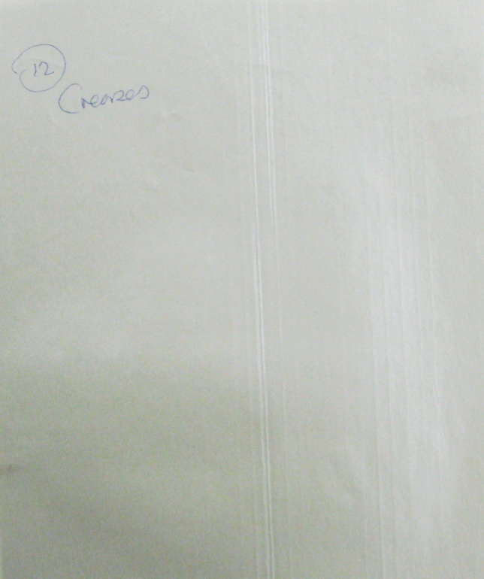
Detection Results
The result is the detection of all types of defects commonly found in material manufacturing processes such as these creases in laminate.

Slide 31
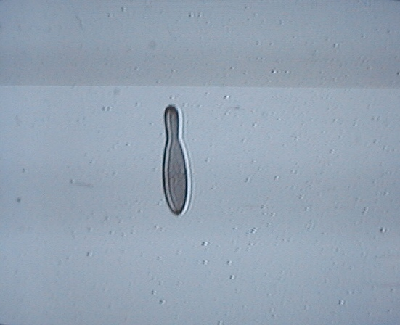
Detection Results
The result is the detection of all types of defects commonly found in material manufacturing processes such as this cyclical embossment in magnetic media.

Slide 32
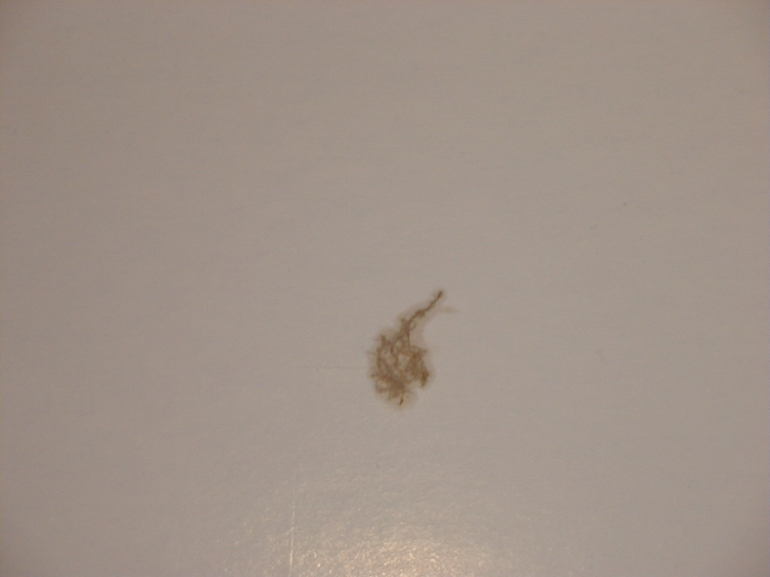
Detection Results
The result is the detection of all types of defects commonly found in material manufacturing processes such as this fiber clump in coated board.

Slide 33
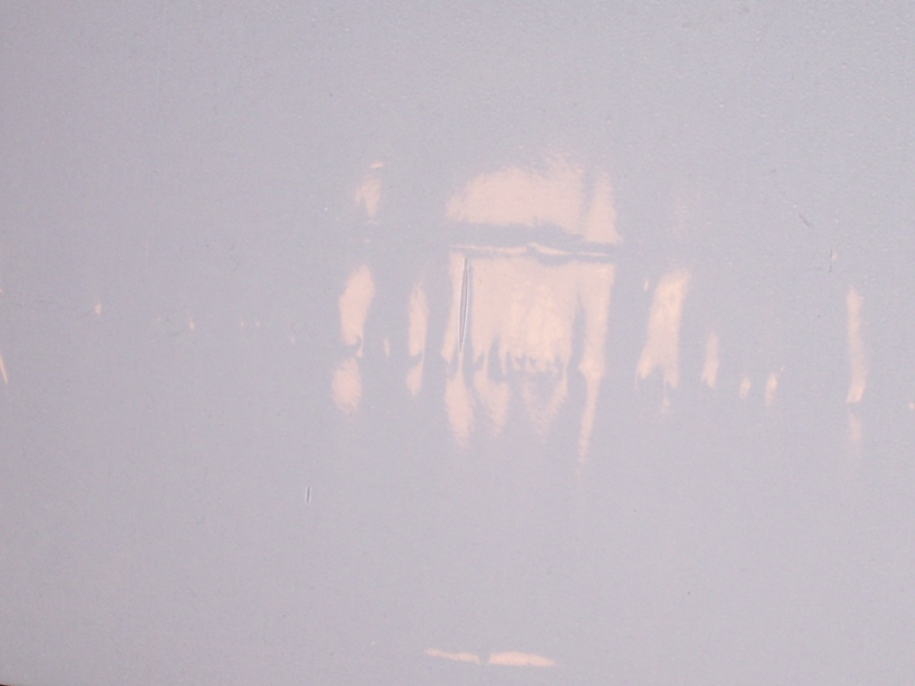
Detection Results
The result is the detection of all types of defects commonly found in material manufacturing processes such as this void in film.

Slide 34
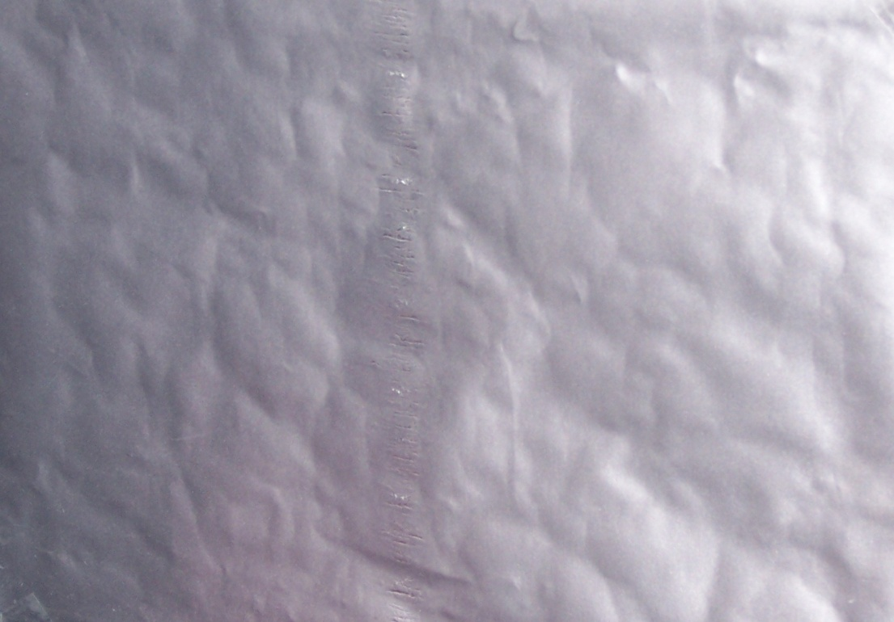
Detection Results
The result is the detection of all types of defects commonly found in material manufacturing processes such as this Chatter in Aluminum Foil.

Slide 35
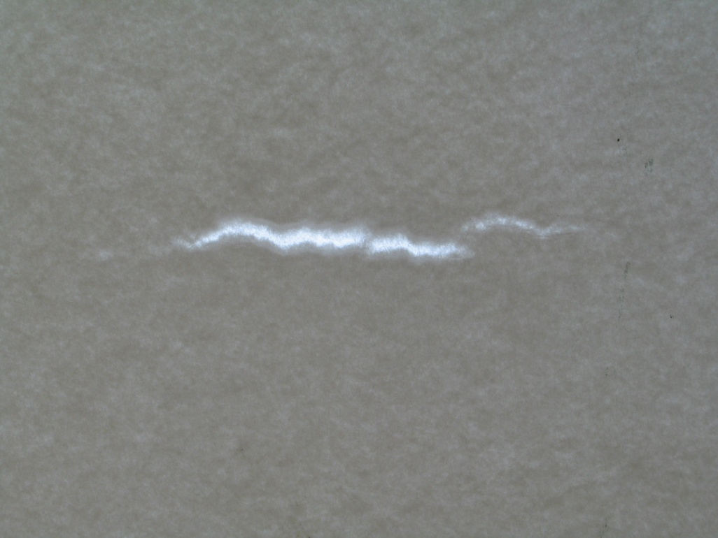
Detection Results
The result is the detection of all types of defects commonly found in material manufacturing processes such as this hole in NCR paper.

Slide 36
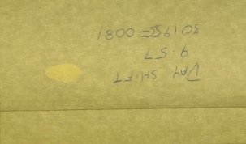
Detection Results
The result is the detection of all types of defects commonly found in material manufacturing processes such as this oil in specialty paper.

Slide 37
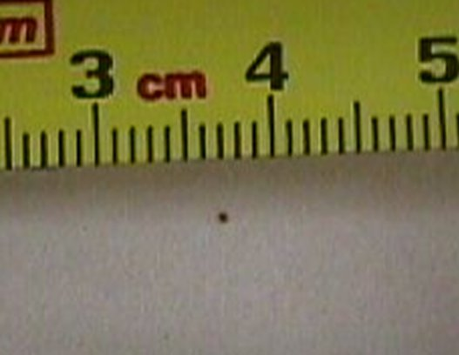
Detection Results
The result is the detection of all types of defects commonly found in material manufacturing processes such as this dirt spot in Newsprint.

Slide 38
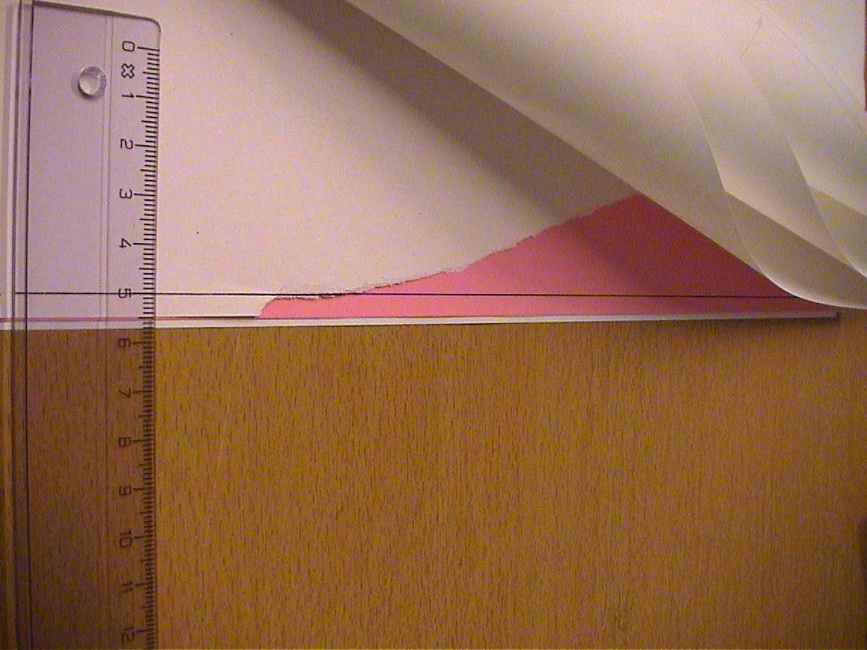
Detection Results
The result is the detection of all types of defects commonly found in material manufacturing processes such as this tearout in specialty paper.

Slide 39
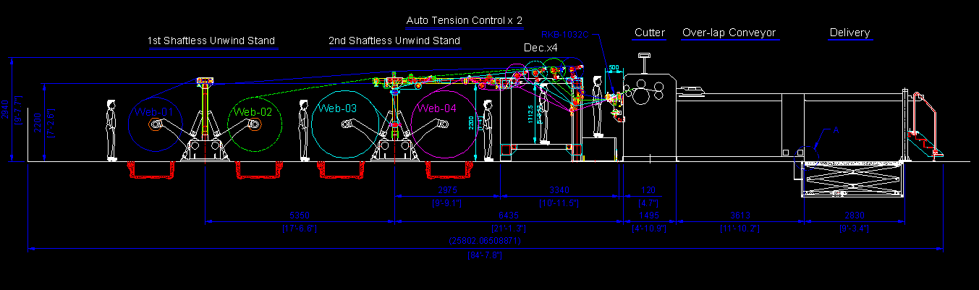
Typical Installation

Slide 40
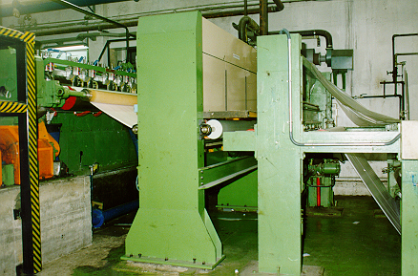
Typical Installation

Slide 41
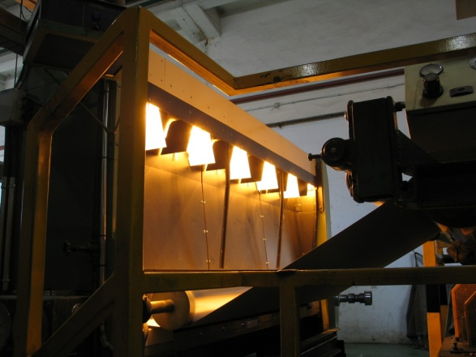




Installation at Major Paper Maker

Slide 42

References
For reliability; large, medium and small companies turn to RKB for their coating streak and scratch defect detection and control needs.

Slide 43
Related Websites
  R.K.B. OPTO-ELECTRONICS, INC., Syracuse, New York, United States
  http://www.rkbopto.com
  R.K.B. Europe, Santander (SPAIN)
  http://rkbdetector.com/
  Arkia Industrial, Sao Paulo, Brasil
  http://www.arkia.com.br
  FIOCCHI Process Instrumentation, Milan, Italy
  http://www. fioproin.it
  Grupo ROSA Automatización y Control S.A. de C.V., Chihuahua, Mexico
  http://gruporosa.com.mx/
  PT. Pentraco Karya Adiprestasi, Jakarta Barat, Indonesia
  http://www.pentraco.com/
  Quality2Process B.V., Hengelo, The Netherlands
  http://www.quality2process.com
  Splice Detector Technologies, Syracuse, New York, United States
  http://www.splicedetector.net / www.hole-detection.com / www.webinspection.us / www.splicedetector.com
  Suzhou Machine Vision Co., Ltd., Suzhou, Jiangsu, China
  http://rkb.chinapaper.net
  Swallow Machinery Co., Ltd., Meltham, Holmfirth, United Kingdom
  http://www.swallowmachinery.com

