Slide 1

System Overview
Model 1478 Defender® Missing Ply™ (web) Detector Technology
Bruce T. Dobbie
Copyright© R.K.B. OPTO-ELECTRONICS, INC. All rights reserved.

Slide 2

Mission Statement
Splice Detector Technologies is a designer and manufacturer of high speed splice, tearout, missing ply and web break detection equipment and related products. We are committed to the industry and our customers that depend on us to ensure that quality is maintained at the highest possible level. We are dedicated to increasing customer satisfaction, continuously improving our products and services, and providing opportunities for our employees to achieve their maximum potential.

Slide 3
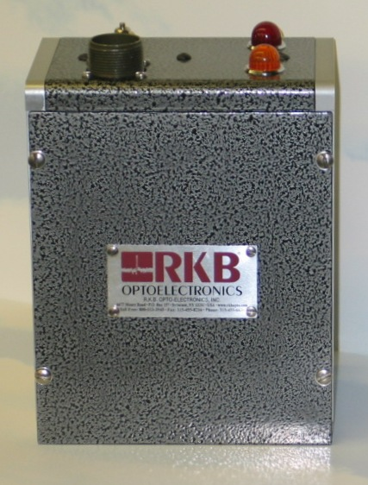
Model 1478 Defender® Missing Ply™ (web) Detector Technology
FOR MORE INFO...
http://www.splicedetector.net/splicedetector_products/missing_ply_detector_technology.html
http://www.splicedetector.com/splicedetector_products/m1478_missing_ply_detector.html

Slide 4

Technology

Slide 5
Overview of Benefits
The Model 1478 Defender® Missing Ply™ (web) Detector Technology is designed to monitor multiple ply web products such as tissue for the occurrence when one of the plies breaks as well as splice type fault defects. The Model 1478 Defender® Missing Ply™ (web) Detector Technology mounts center of web and is completely self calibrating to any product grade, web speed, or color. It solves product quality issues prior to subsequent conversion processes where web ply breaks or splices may damage sensitive equipment. The Model 1478 Defender® Missing Ply™ (web) Detector Technology is intended for conversion or finishing rooms of multiple play products such as facial tissue, toilet tissues, multi layer filters, and any other conversion process involving multiple ply products.

Slide 6
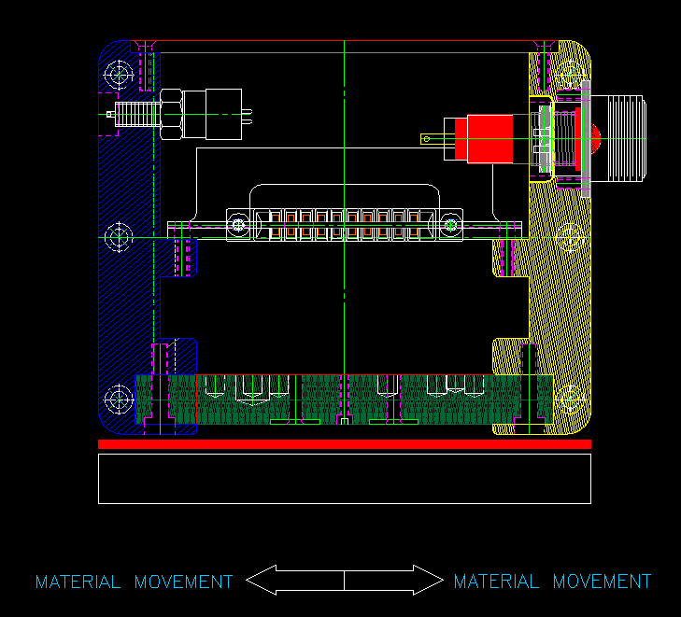
Features and Benefits
Every Model 1478 Defender® Missing Ply™ (web) Detector Technology is handcrafted to specific standards which facilitates inter-changeability and performance.

Slide 7
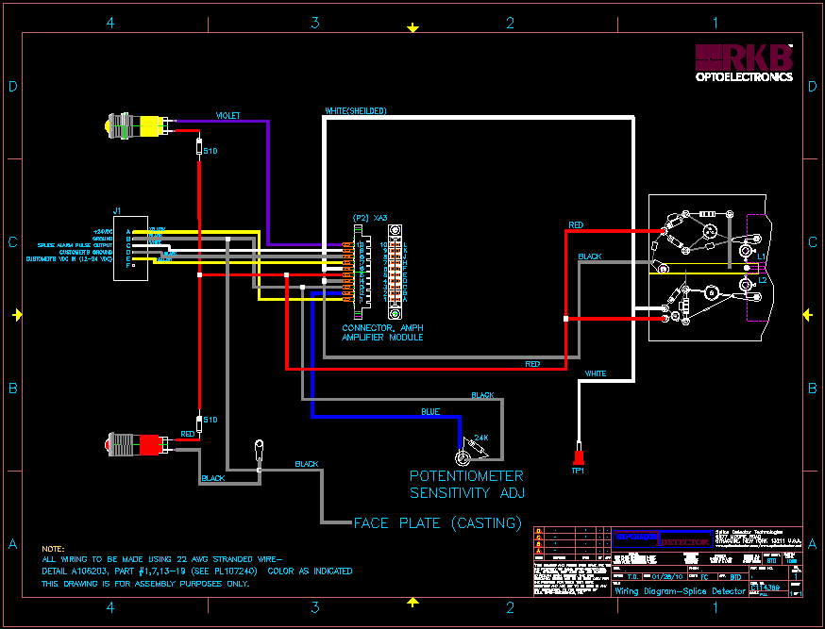
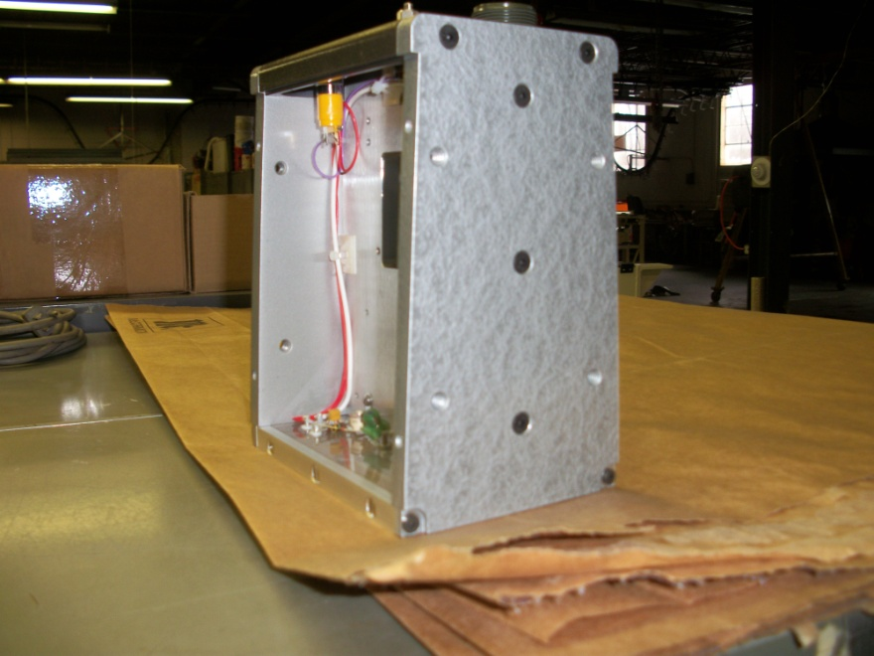
Features and Benefits
Our Model 1478 Defender® Missing Ply™ (web) Detector Technology was designed to facilitate a cost effective solution for multiple ply products like tissue where the break of a ply may be too subtle for conventional photo eye or ultrasonic type technologies.

Slide 8



Features and Benefits
The Model 1478 Defender® Missing Ply™ (web) Detector Technology monitors any non-metallic multi ply web format process where potential ply breaks occur.

Slide 9
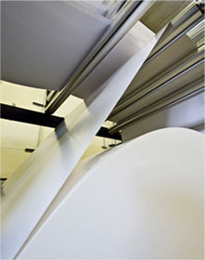
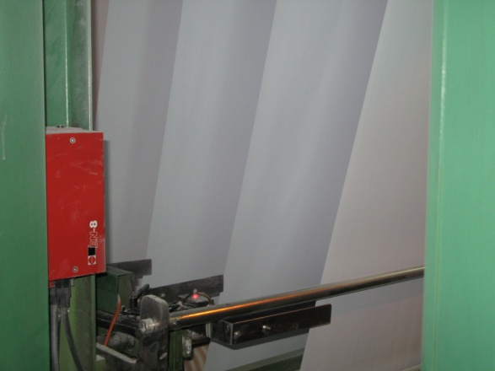
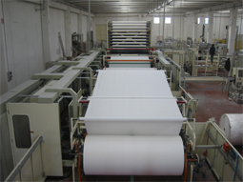
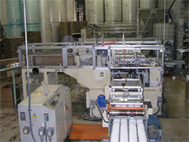
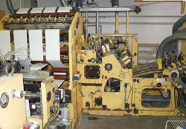
Features and Benefits
The Model 1478 Defender® Missing Ply™ (web) Detector Technology monitor single to multiple webs of multiply material simultaneously at one inspection point.

Slide 10
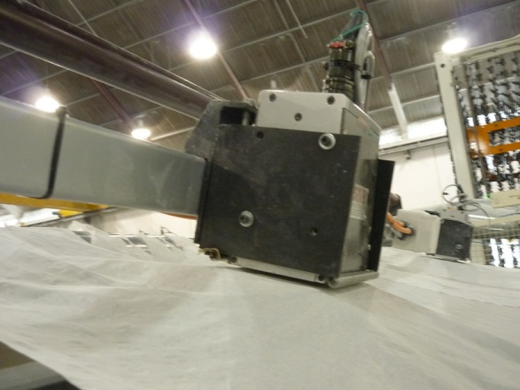
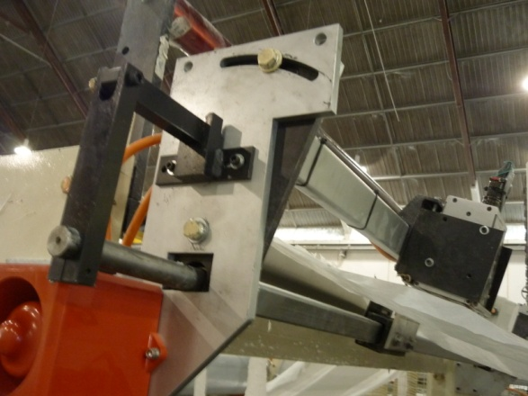
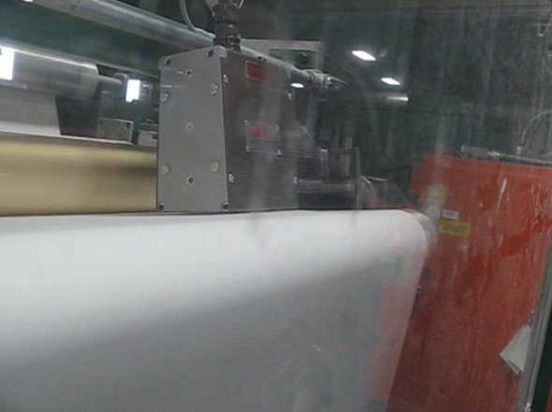
Features and Benefits
The Model 1478 Defender® Missing Ply™ (web) Detector Technology is unaffected by material basis weight changes, color or process speed (highest recorded installation @ 5000 fpm (1524 m/min).

Slide 11



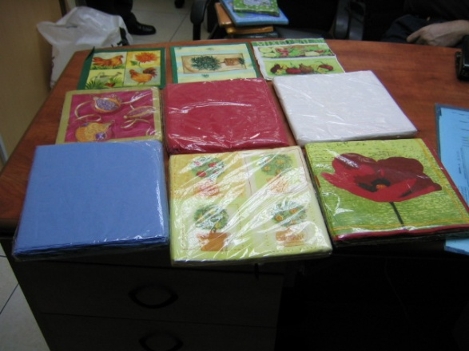

Features and Benefits
The Model 1478 Defender® Missing Ply™ (web) Detector Technology is unaffected by printed material.

Slide 12
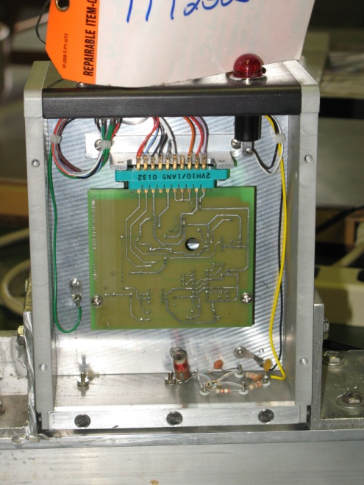
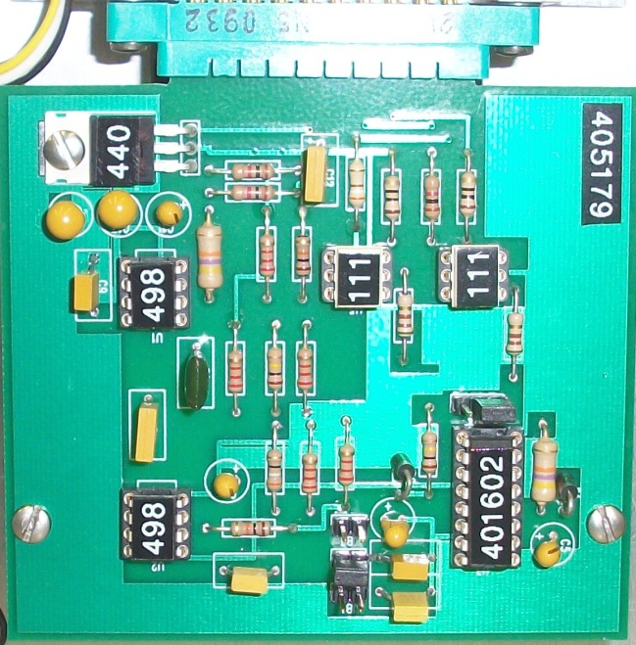
Features and Benefits
The Model 1478 Defender® Missing Ply™ (web) Detector Technology incorporates state-of-the-art electronic design circuitry, components, filtering and processing techniques unequaled in the industry. Opt-isolated 24VDC output with selectable 1, 10 or 100 millisecond time base.

Slide 13
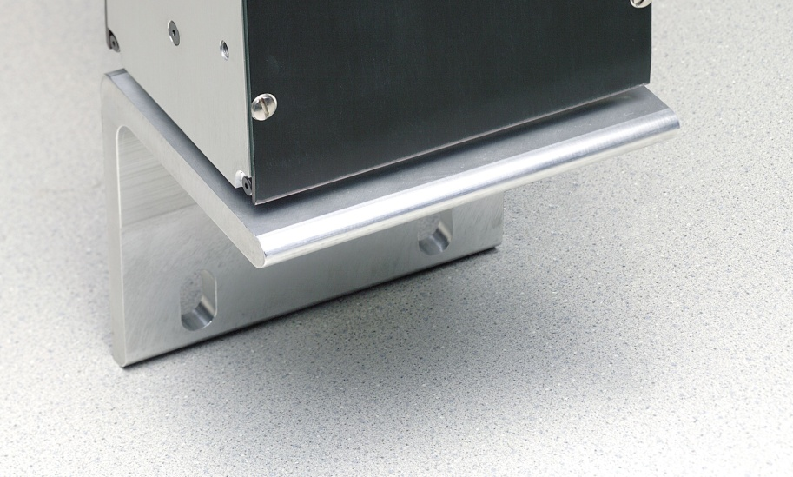
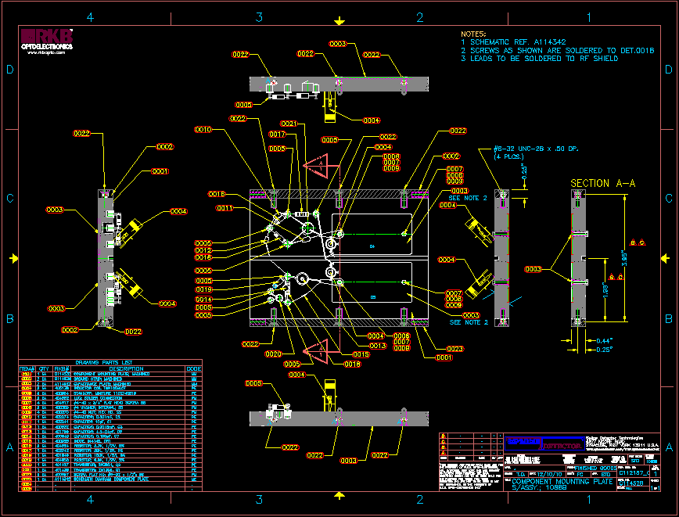
Features and Benefits
State-of-the-Art Proprietary Sensing Platform.

Slide 14
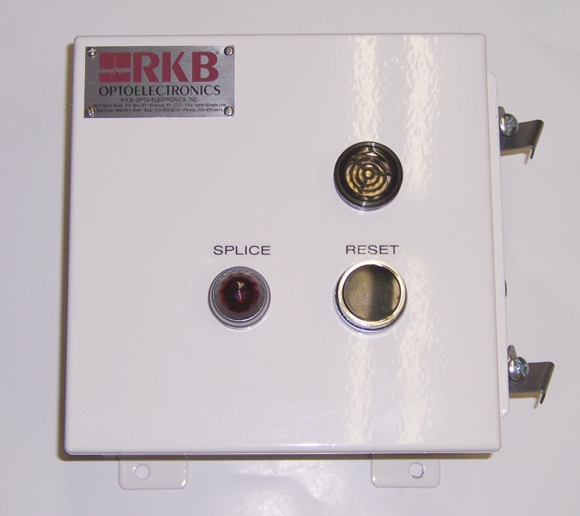
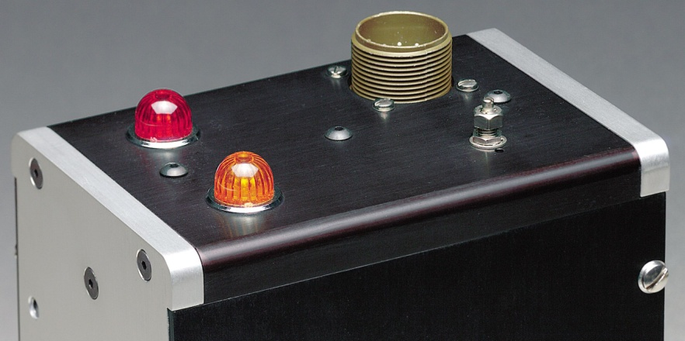
Features and Benefits
Highly visible indicator lamps and optional audio/visual alarms provide immediate alert to operational staff of critical splices. Provide user friendly outputs you can actually use too process control instrumentation.

Slide 15
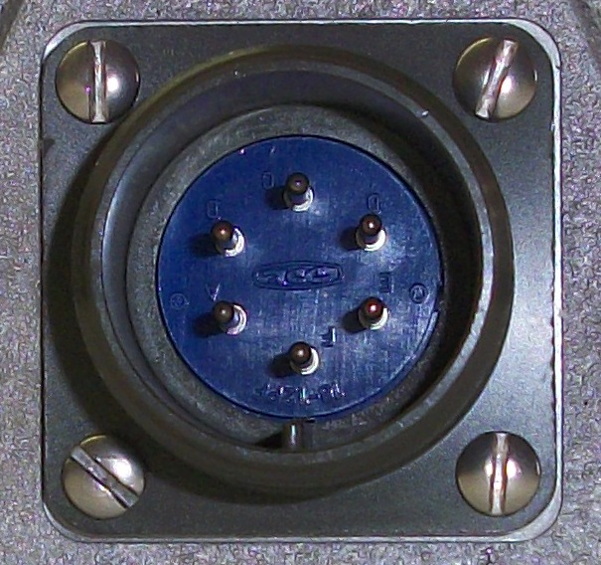
Features and Benefits
Military type connections ensure solid electrical specifications are maintained and environmental protection is achieved.

Slide 16
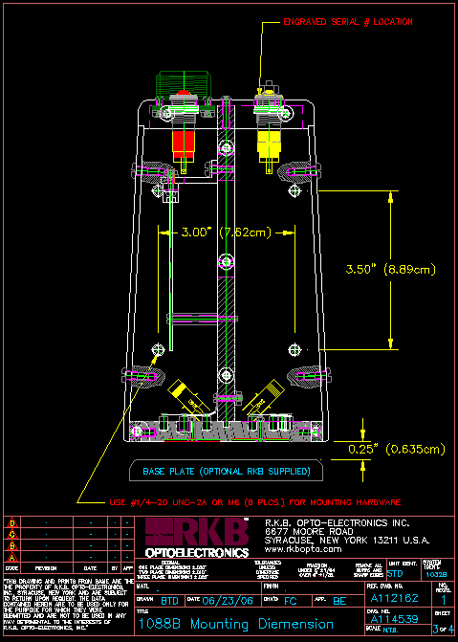
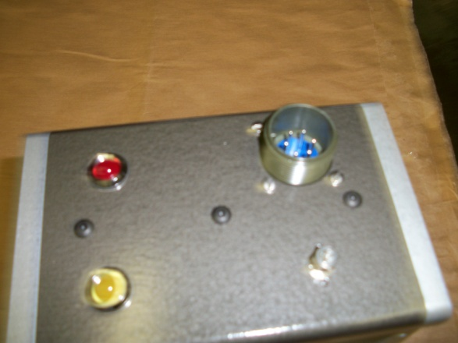
Features and Benefits
Automatic recalibration on product grade changes.

Slide 17
Features and Benefits
Meets quality initiative and ISO requirements.
Detection 24/7 without the need for operational intervention.
Eliminate the need for manual inspections.
Detection of “ALL” Missing Plies, Guaranteed!
CE, CCC and RoHS Compliant

Slide 18
Applications
Sheeters
Wide Format Printing
Roto
Laminators
Slitters
Coaters
Non-wovens

Slide 19
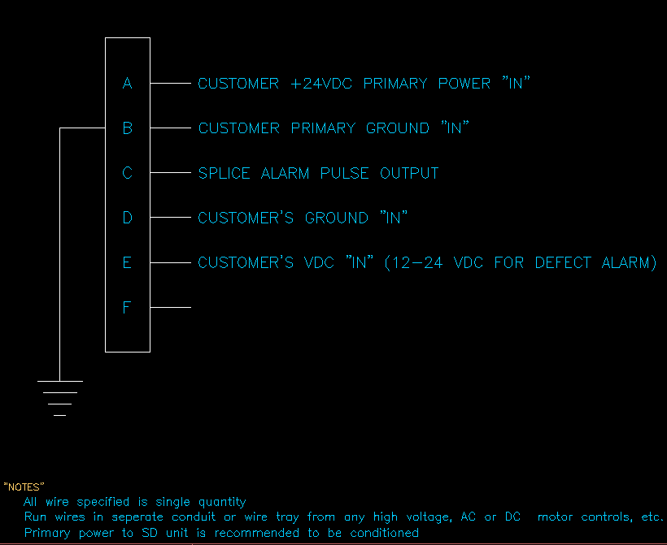
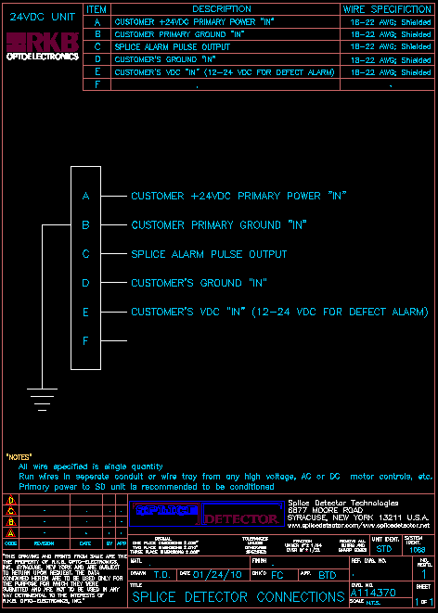
Power Requirements

Slide 20
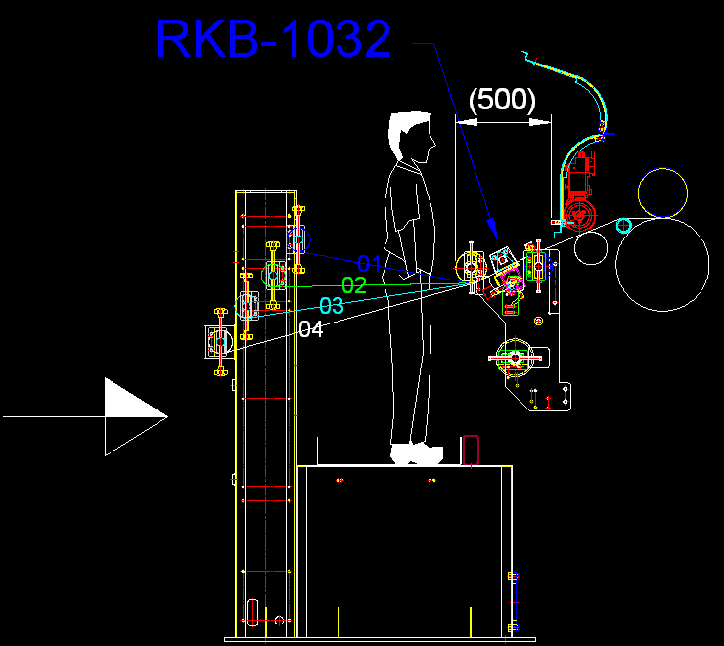
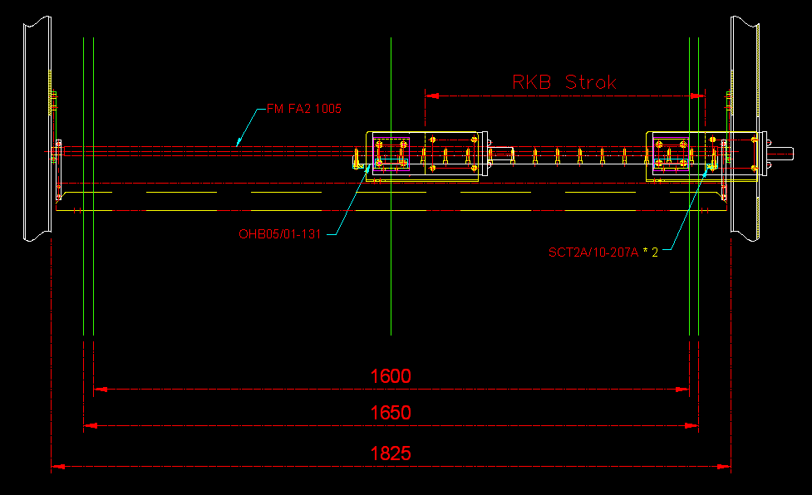
Typical Installation

Slide 21
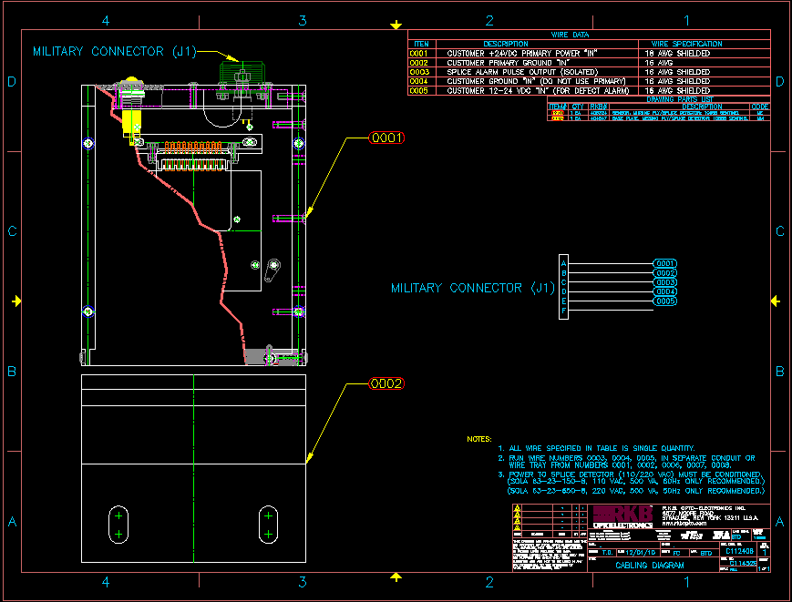
Typical Installation

Slide 22
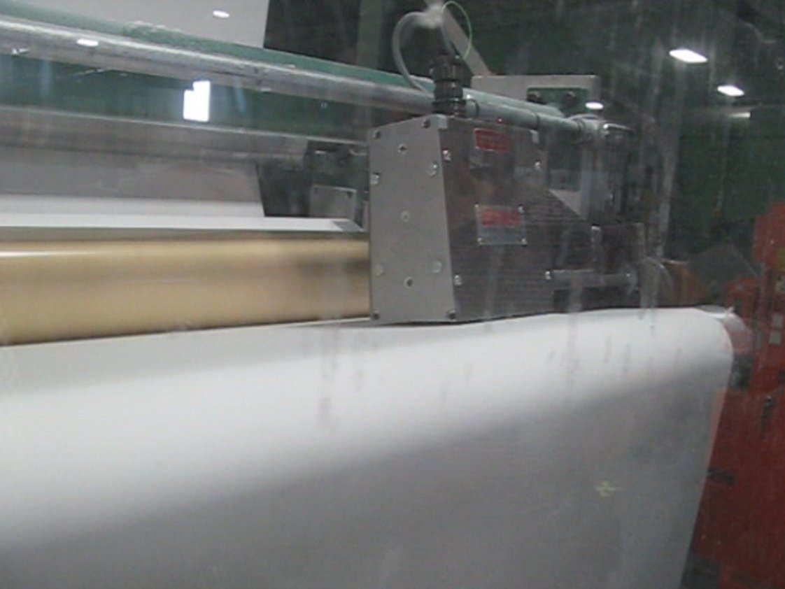
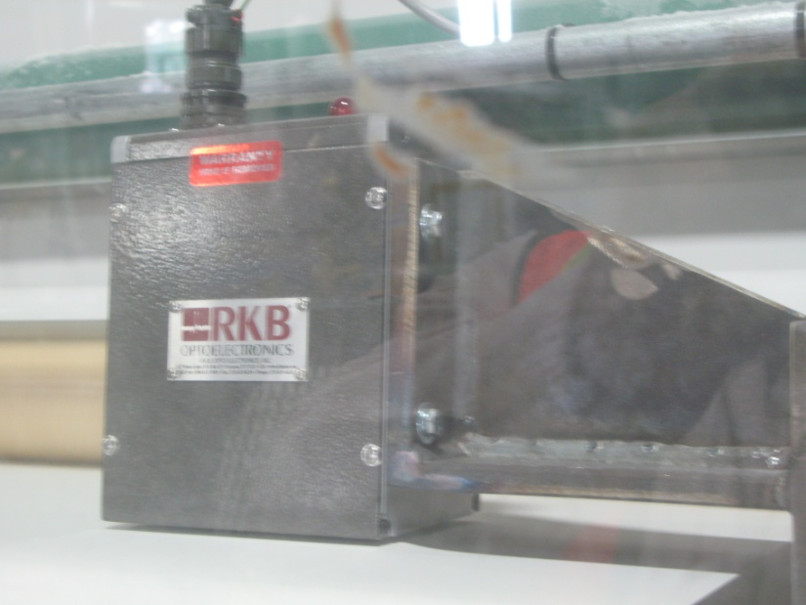
Installation at Major Paper Maker

Slide 23

References
For reliability; large, medium and small companies turn to RKB for their missing ply detection needs.

Slide 24
Related Websites
R.K.B. OPTO-ELECTRONICS, INC., Syracuse, New York, United States
http://www.rkbopto.com
R.K.B. Europe, Santander (SPAIN)
http://rkbdetector.com/
Arkia Industrial, Sao Paulo, Brasil
http://www.arkia.com.br
FIOCCHI Process Instrumentation, Milan, Italy
http://www. fioproin.it
Grupo ROSA Automatización y Control S.A. de C.V., Chihuahua, Mexico
http://gruporosa.com.mx/
PT. Pentraco Karya Adiprestasi, Jakarta Barat, Indonesia
http://www.pentraco.com/
Quality2Process B.V., Hengelo, The Netherlands
http://www.quality2process.com
Splice Detector Technologies, Syracuse, New York, United States
http://www.splicedetector.net / www.hole-detection.com / www.webinspection.us / www.splicedetector.com
Suzhou Machine Vision Co., Ltd., Suzhou, Jiangsu, China
http://rkb.chinapaper.net
Swallow Machinery Co., Ltd., Meltham, Holmfirth, United Kingdom
http://www.swallowmachinery.com

