Slide 1
System Overview
Model 1280 Guardian® Multicolor Edge Marking™ Technology
Bruce T. Dobbie
Copyright© R.K.B. OPTO-ELECTRONICS, INC. All rights reserved.

Slide 2
Mission Statement
Splice Detector Technologies is a designer and manufacturer of high speed splice, tearout, missing ply and web break detection equipment and related products. We are committed to the industry and our customers that depend on us to ensure that quality is maintained at the highest possible level. We are dedicated to increasing customer satisfaction, continuously improving our products and services, and providing opportunities for our employees to achieve their maximum potential.

Slide 3
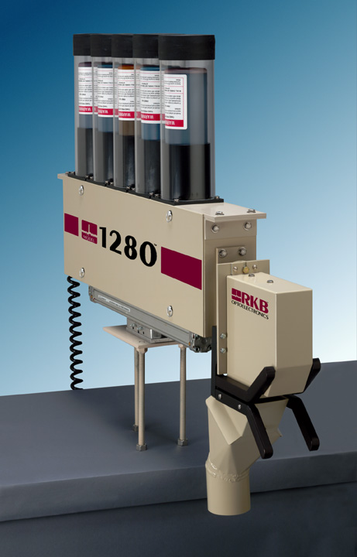
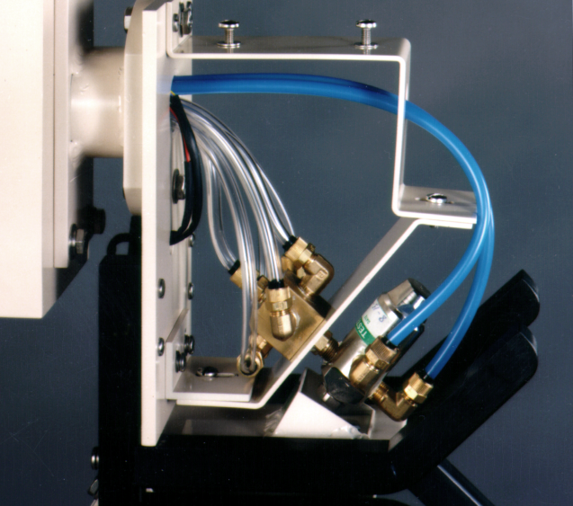
Model 1280 Guardian® Multicolor Edge Marking™ Technology
FOR MORE INFO...
http://www.splicedetector.net/splicedetector_products/edge_marking_technology.html
http://www.splicedetector.com/splicedetector_products/m1280_spray_marking.html

Slide 4
Technology

Slide 5
Overview of Benefits
The Model 1280 Guardian® Multicolor Edge Marking™ Technology was designed to be integrated into any inspection or online analytical devices where tagging defective or quality issues by way of marking the web is required. The technology which comes in multicolor format can be used to identify quality defects or be used to indicate if other processes have malfunctioned allowing production to quickly and easily identify and correct quality and/or control issues. This technology will mark the edge of web material with safe and recyclable inks.

Slide 6
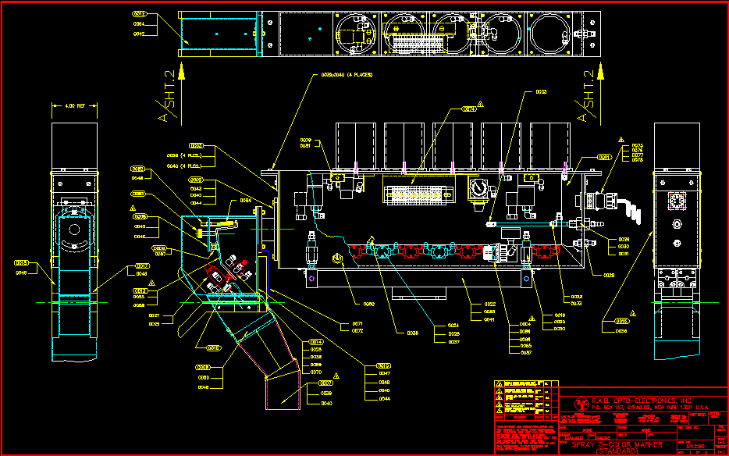
Features and Benefits
Every Model 1280 Guardian® Multicolor Edge Marking™ Technology is handcrafted to specific standards which facilitates inter-changeability and performance.

Slide 7
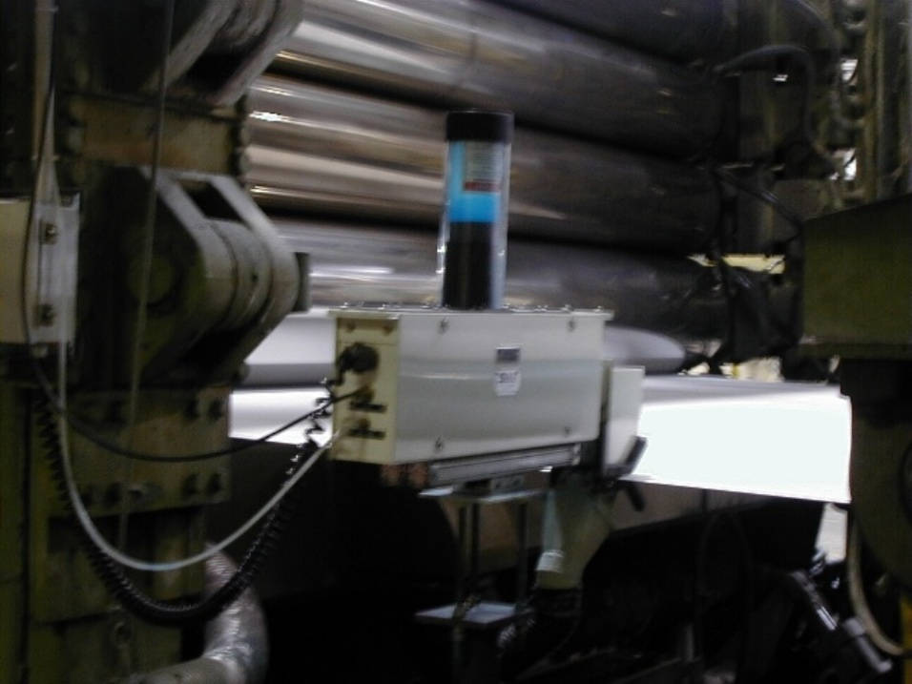
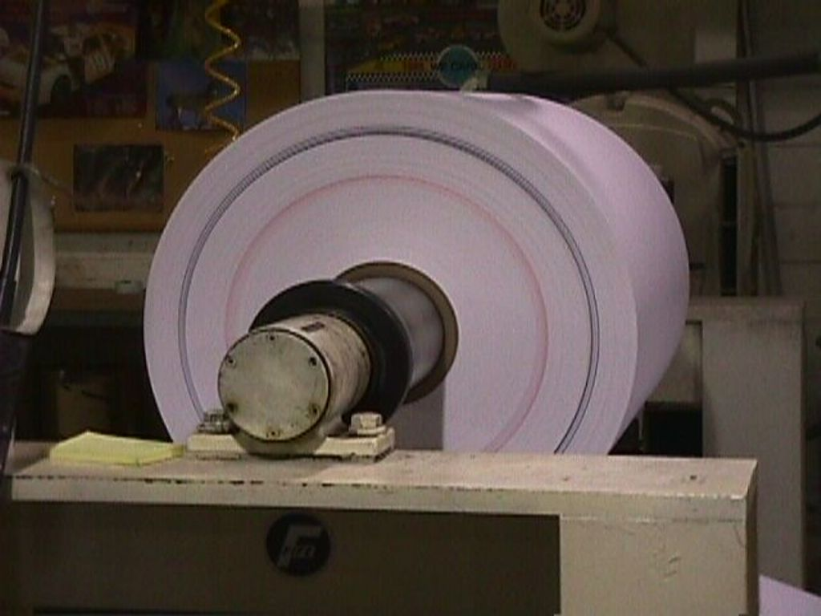
Features and Benefits
Applicable to most web based materials, the Model 1280 Guardian® Multicolor Edge Marking™ Technology will apply, by way of atomizing, a layer of colored ink along the edge of the web which appears as a concentric circle clearly visible at a distance.

Slide 8
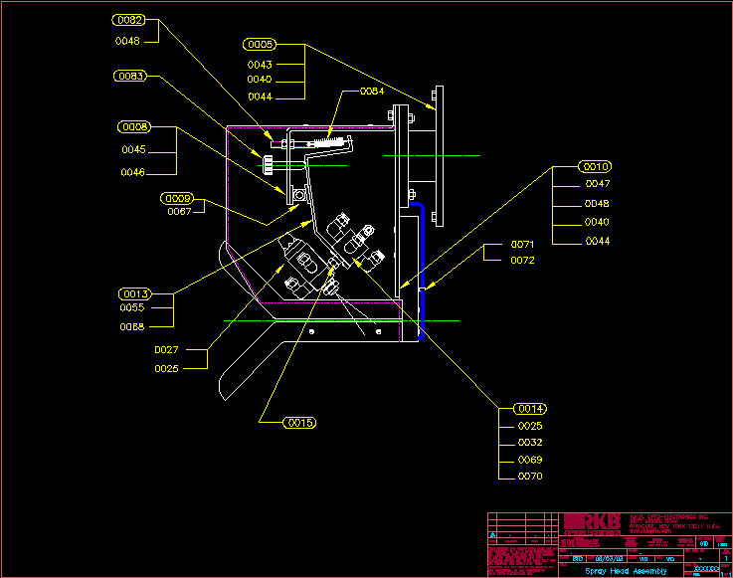
Features and Benefits
Multicolor air atomizing spray head allows instant color changes enabling shorter marks at higher speeds

Slide 9
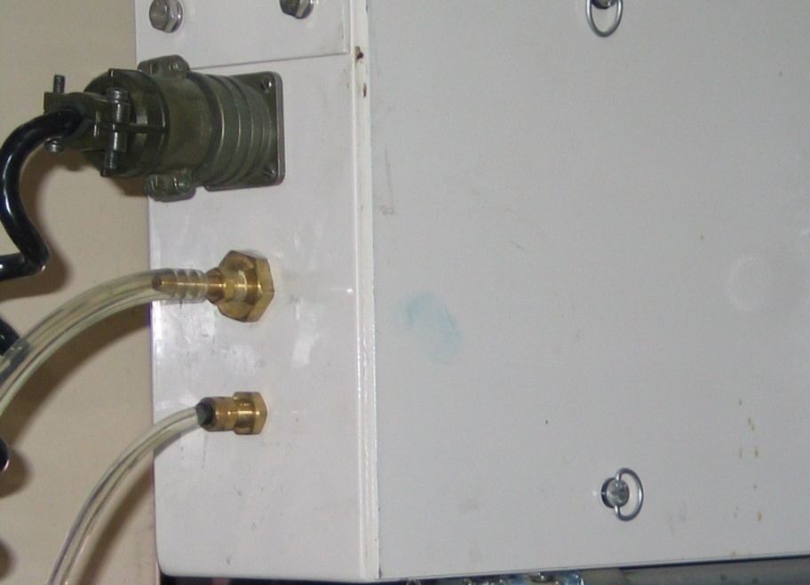
Features and Benefits
Improved and automatic adjustable water flush and cleaning standards which ensure critical components remain debris free for longer operational life while eliminating operational intervention.

Slide 10
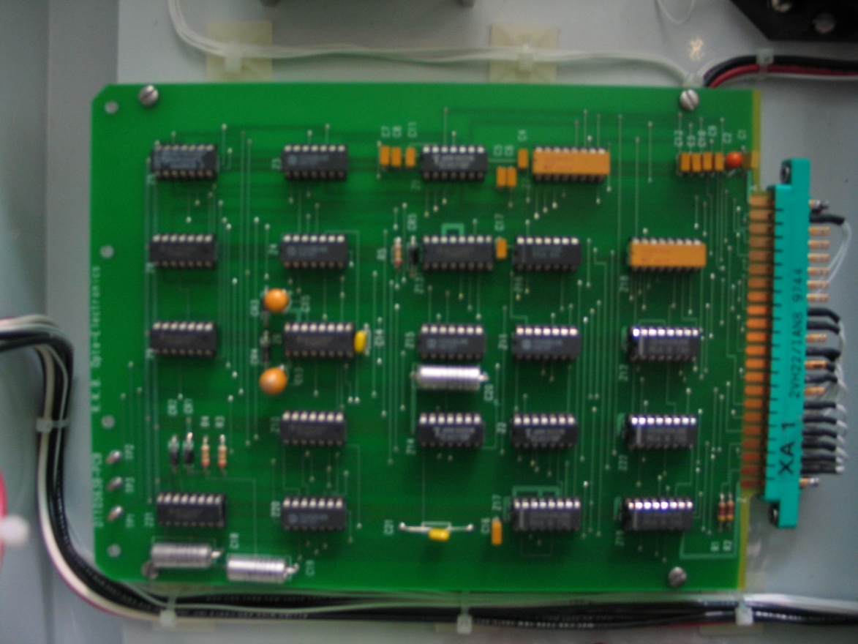
Features and Benefits
Length or time based defect marking for improved unwind accuracy.

Slide 11
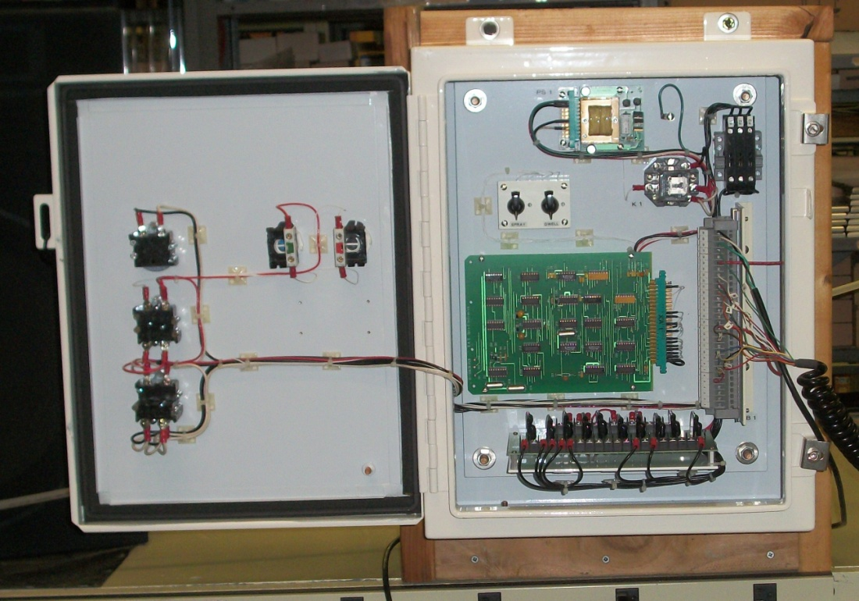
Features and Benefits
Maintenance and diagnostics display panel with alarm outputs such as ink levels, air pressure, tracking issues, and others.

Slide 12
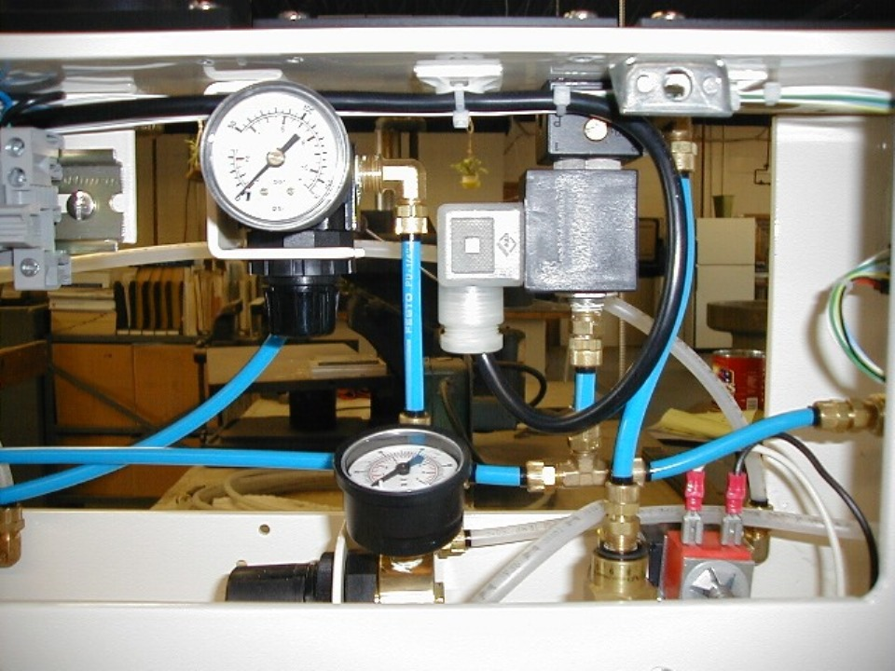
Features and Benefits
Reduced ink usage due to the ability to produce identification marks that require “NO” mix times.

Slide 13
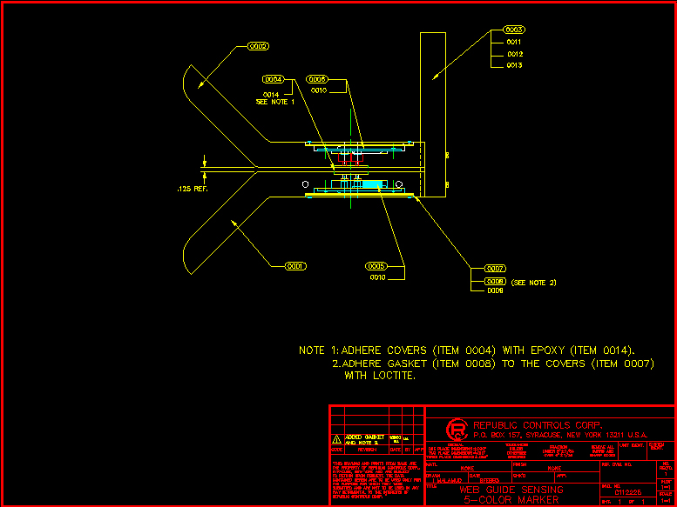
Features and Benefits
Automatic edge tracking.

Slide 14
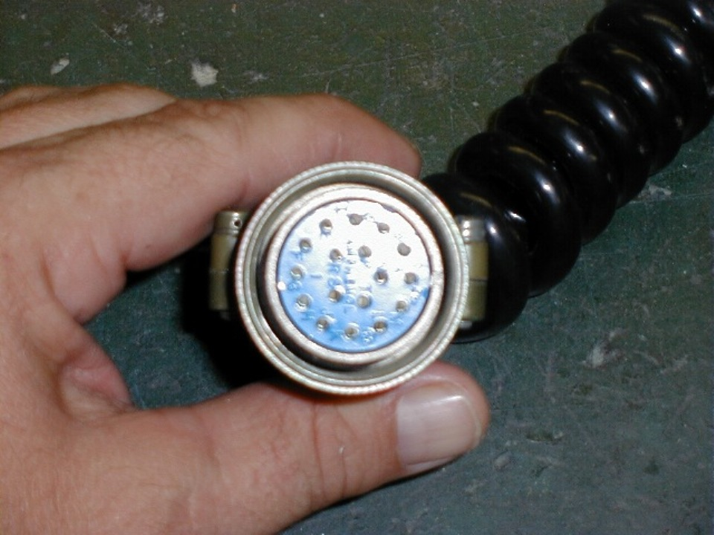
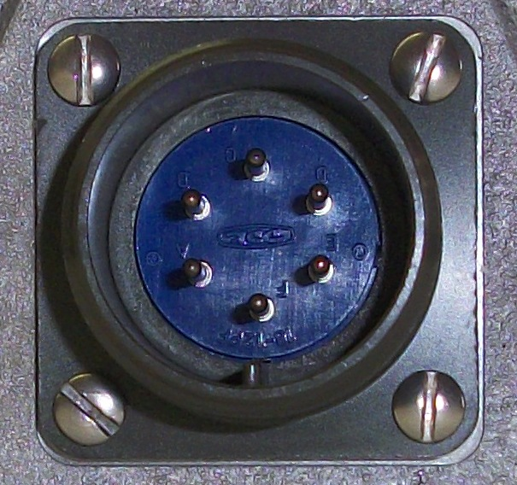
Features and Benefits
Mil spec connections ensure solid electrical specifications are maintained and environmental protection is achieved

Slide 15
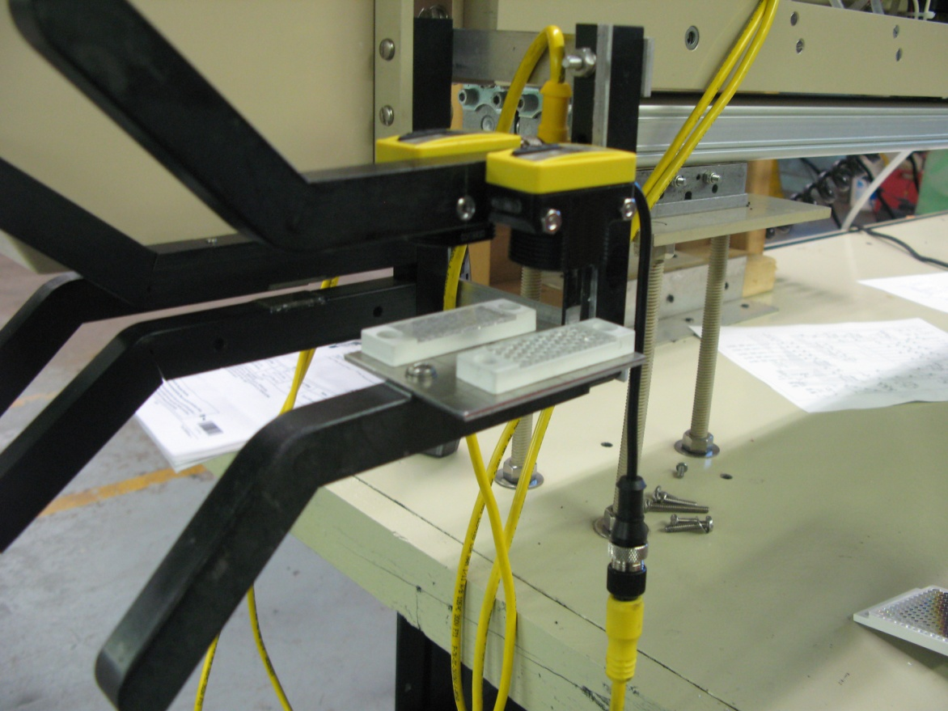
Features and Benefits
Automatic sheet break retraction.

Slide 16
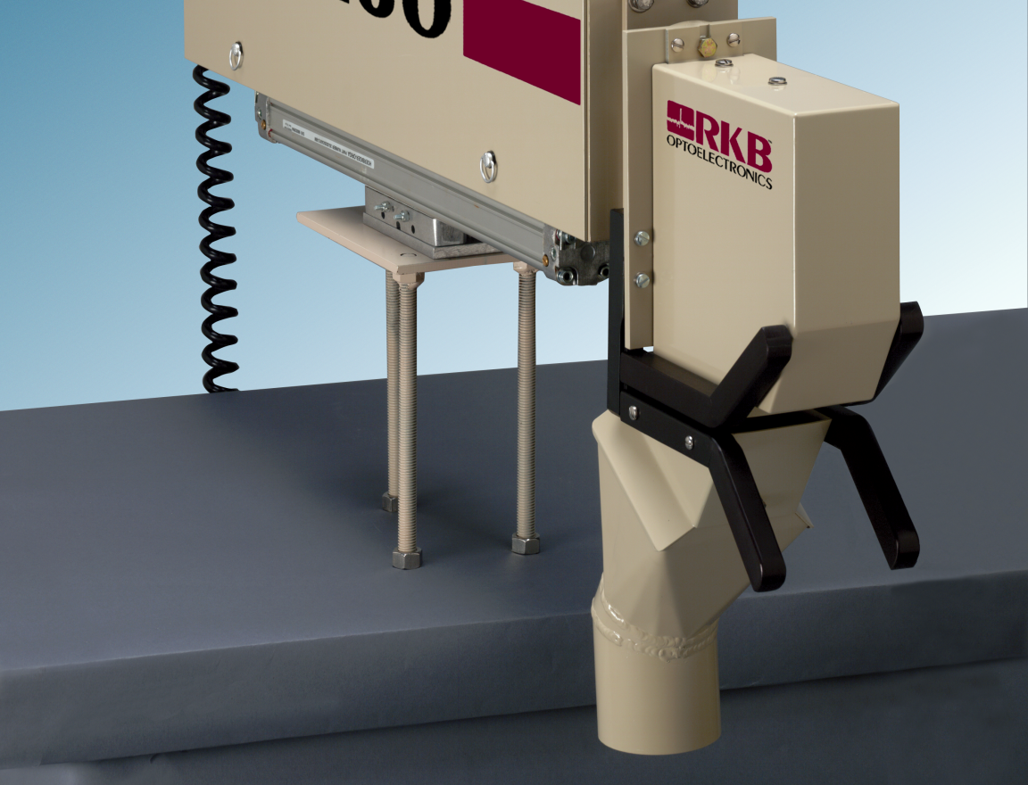
Features and Benefits
Over spray and mist evacuation system.

Slide 17
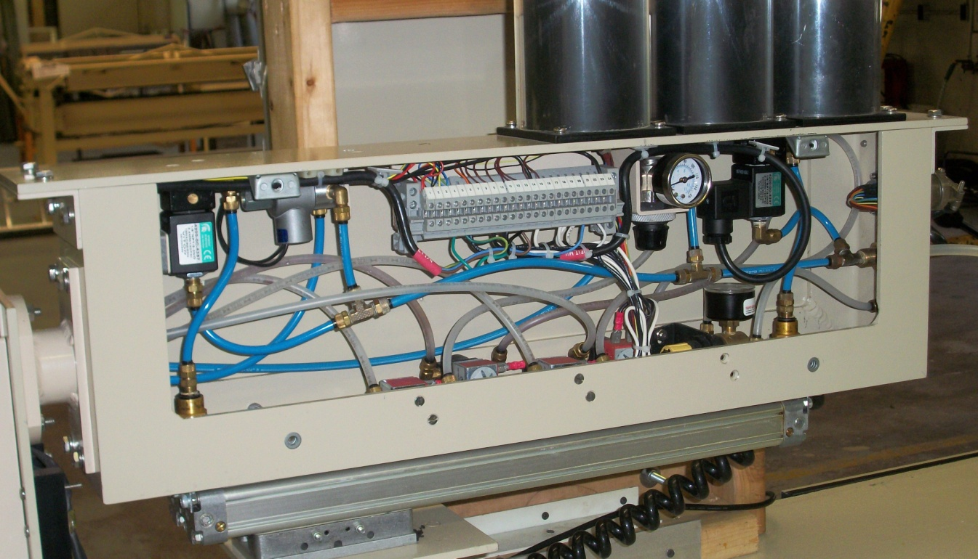
Features and Benefits
All critical components and tubing are housed in a non-corrosive aluminum housing with “no” exposed or unprotected tubing.

Slide 18
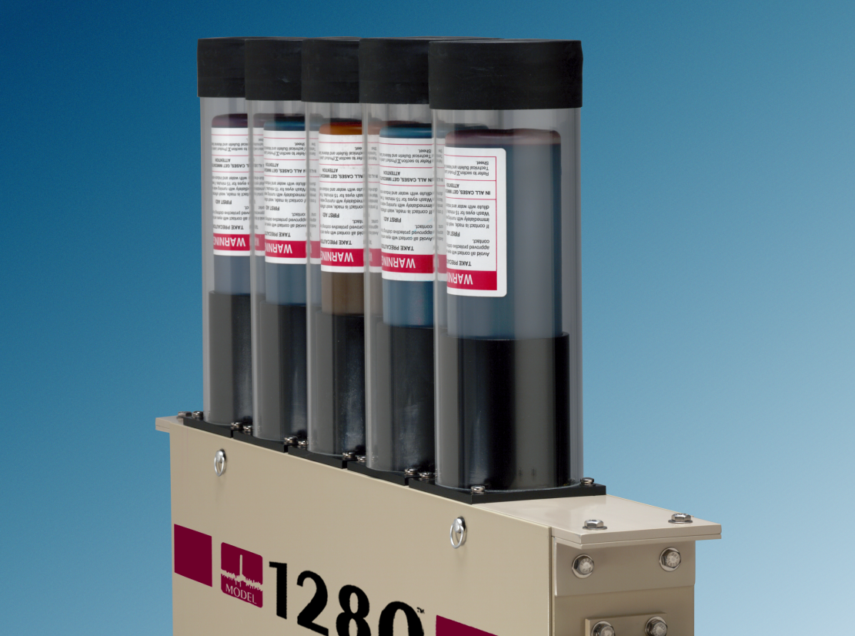
Features and Benefits
Water soluble ink is standard, but any type of dye fluid can be utilized including UV curable inks.

Slide 19
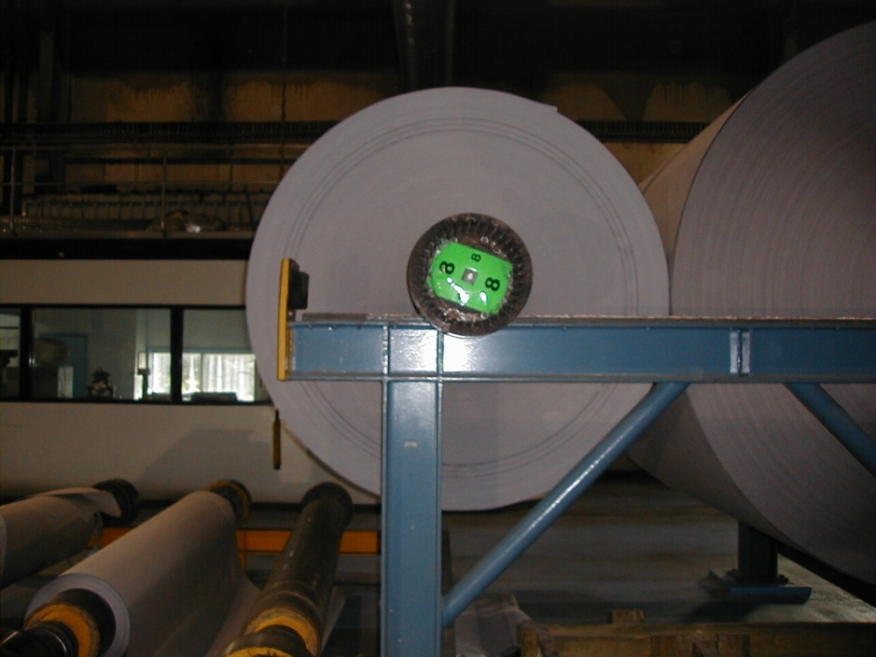
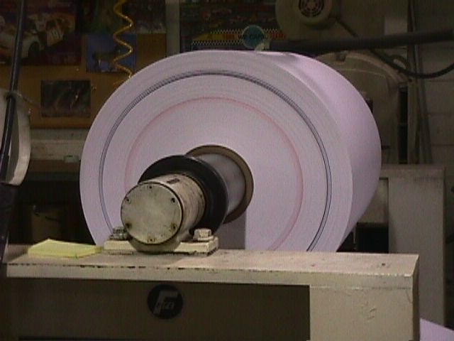
Features and Benefits
Coding Function to facilitate accurate stop on winding/rewinding applications where defects are required to be culled out prior to subsequent processes.

Slide 20
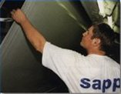
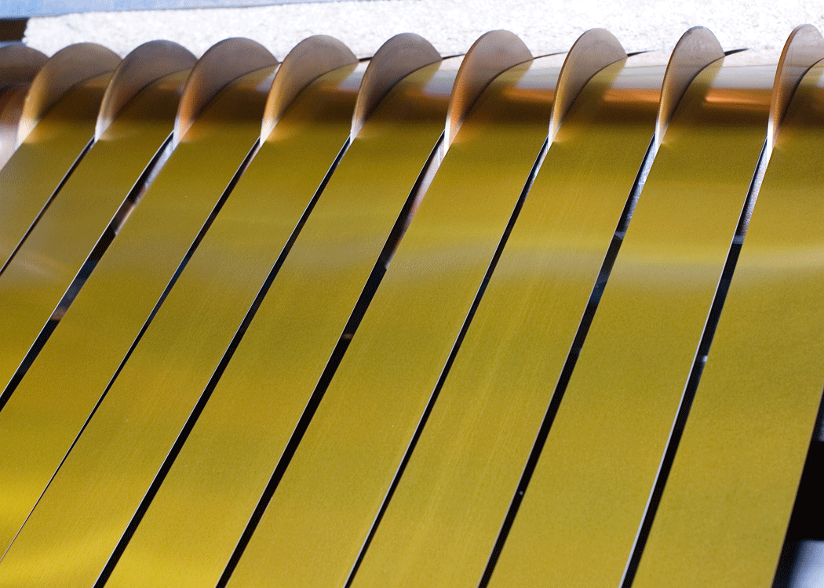
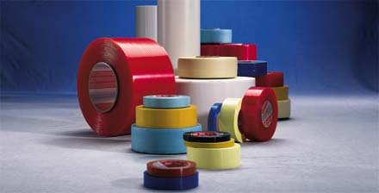
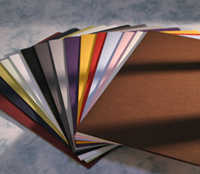
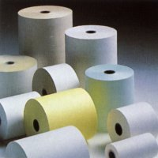
Features and Benefits
Can be applied to almost any web based material where the indemnification of defects or out of spec processes are required.

Slide 21
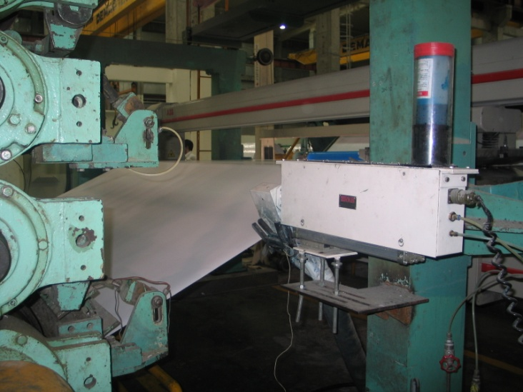
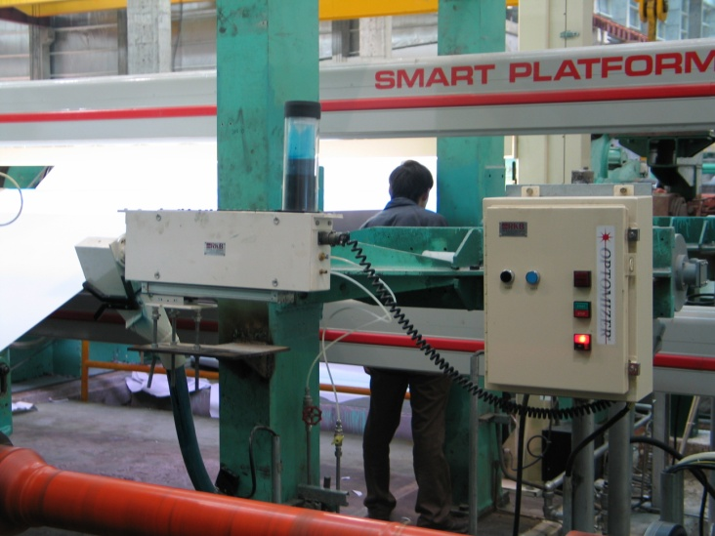
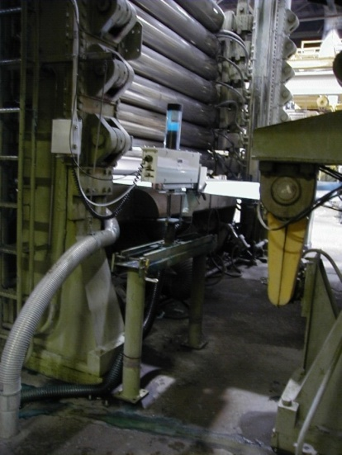
Features and Benefits
Unaffected by material basis weight changes, color or process speed.

Slide 22
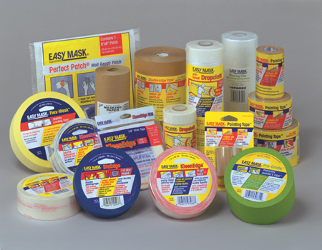
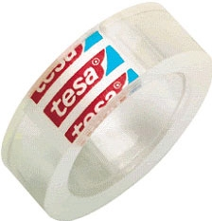
Features and Benefits
Unaffected by printed material.

Slide 23
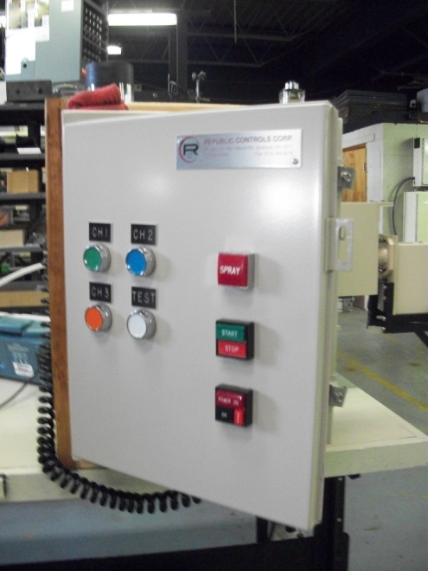
Features and Benefits
Highly visible indicator lamps and optional audio/visual alarms provide immediate alert to operational staff of critical issues. Provide user friendly outputs you can actually use too process control instrumentation.

Slide 24
Features and Benefits
Meets quality initiative and ISO requirements.
Operation 24/7 without the need for operational intervention.
Eliminate the need for manual rejection of defects.
Eliminate the need for manual marking of defects, Guaranteed
CE, CCC and RoHS Compliant

Slide 25
Applications
Paper Machines
Wide Format Printing
Roto
Laminators
Slitters
Coaters
Non-wovens

Slide 26
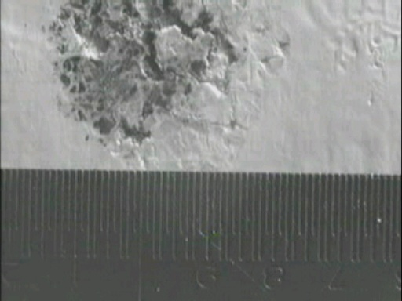
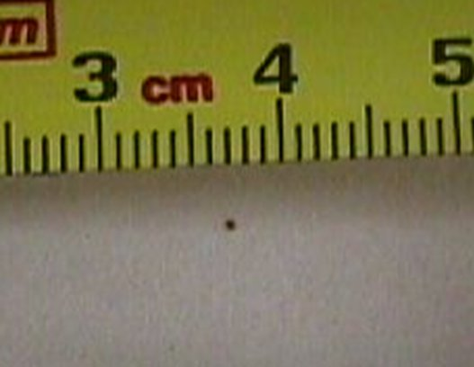
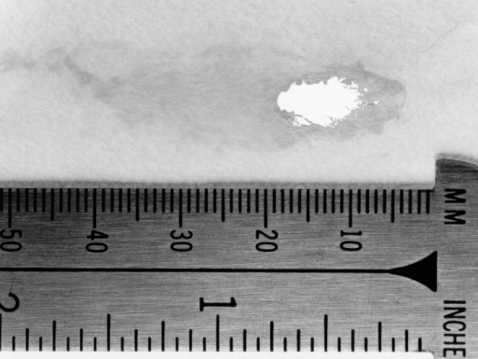
Marking Results
The result is the identification of critical defect faults or out of spec processes for cull out that will cause down time, damage to subsequent processes and customer complaints and charges.

Slide 27
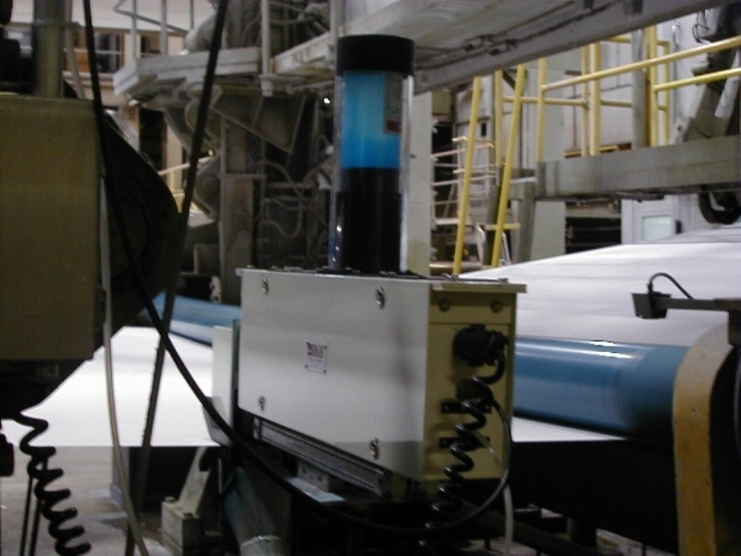
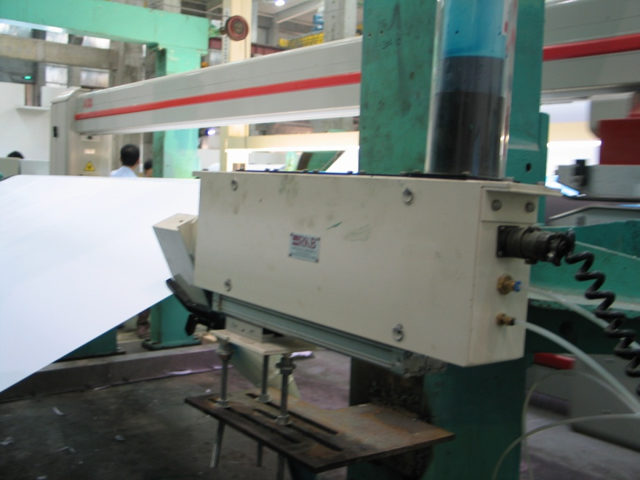
Installation at Major Paper Maker

Slide 28
References
For reliability; large, medium and small companies turn to RKB for their edge marking needs.

Slide 29
Related Websites
R.K.B. OPTO-ELECTRONICS, INC., Syracuse, New York, United States
http://www.rkbopto.com
R.K.B. Europe, Santander (SPAIN)
http://rkbdetector.com/
Arkia Industrial, Sao Paulo, Brasil
http://www.arkia.com.br
FIOCCHI Process Instrumentation, Milan, Italy
http://www. fioproin.it
Grupo ROSA Automatización y Control S.A. de C.V., Chihuahua, Mexico
http://gruporosa.com.mx/
PT. Pentraco Karya Adiprestasi, Jakarta Barat, Indonesia
http://www.pentraco.com/
Quality2Process B.V., Hengelo, The Netherlands
http://www.quality2process.com
Splice Detector Technologies, Syracuse, New York, United States
http://www.splicedetector.net / www.hole-detection.com / www.webinspection.us / www.splicedetector.com
Suzhou Machine Vision Co., Ltd., Suzhou, Jiangsu, China
http://rkb.chinapaper.net
Swallow Machinery Co., Ltd., Meltham, Holmfirth, United Kingdom
http://www.swallowmachinery.com

