Slide 1

System Overview
Model 1088 Sentinel® Splice Detector™ Technology
Bruce T. Dobbie
Copyright© R.K.B. OPTO-ELECTRONICS, INC. All rights reserved.

Slide 2

Mission Statement
Splice Detector Technologies is a designer and manufacturer of high speed splice, tearout, missing ply and web break detection equipment and related products. We are committed to the industry and our customers that depend on us to ensure that quality is maintained at the highest possible level. We are dedicated to increasing customer satisfaction, continuously improving our products and services, and providing opportunities for our employees to achieve their maximum potential.

Slide 3
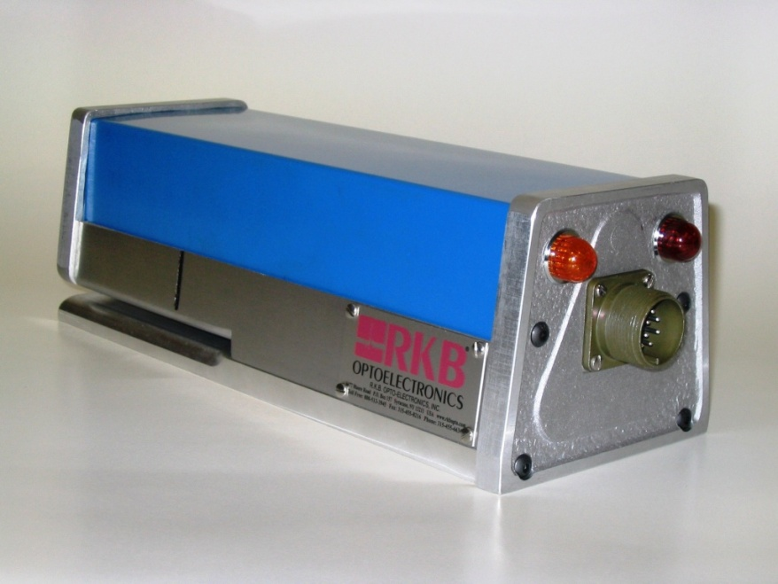
Model 1088 Sentinel® Splice Detector™ Technology
FOR MORE INFO...
http://www.splicedetector.net/splicedetector_products/sentinel_splice_detector_technology.html
http://www.splicedetector.com/splicedetector_products/m1088_sentinel_splicedetector.html

Slide 4

Technology

Slide 5
Overview of Benefits
The Model 1088 Sentinel® Splice Detector™ Technology is designed to monitor non-metallic webs of material for the presence of splices (joints) and tearouts. The Model 1088 Sentinel® Splice Detector™ Technology mounts edge of web and is completely self calibrating to any product grade, web speed, or color. It solves product quality issues at point of packaging or prior to subsequent conversion processes where splices may damage sensitive equipment like coating heads, print heads, embossers, etc… The Model 1088 Sentinel® Splice Detector™ Technology is intended for finishing rooms, printers, laminators, coaters and any other conversion process.

Slide 6
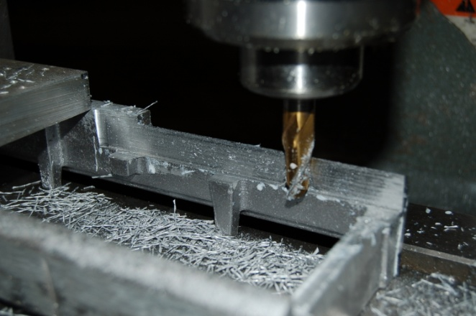
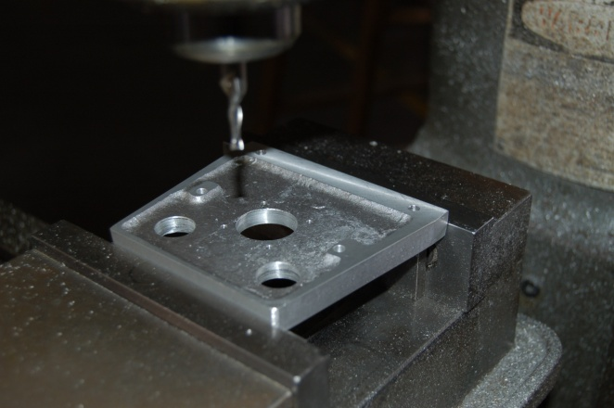
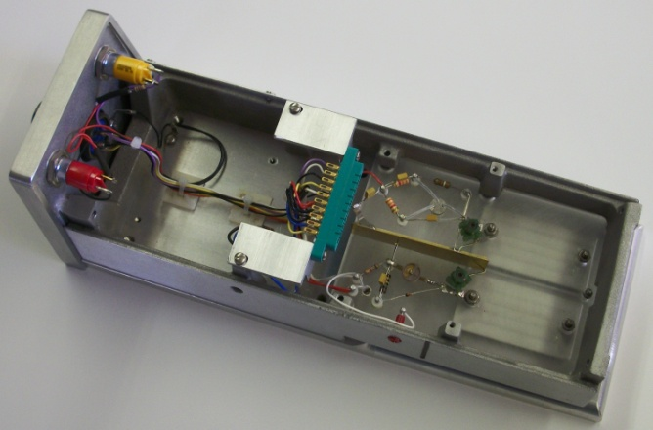
Features and Benefits
Every Model 1088 Sentinel® Splice Detector™ is handcrafted to specific standards which facilitates inter-changeability and performance.

Slide 7
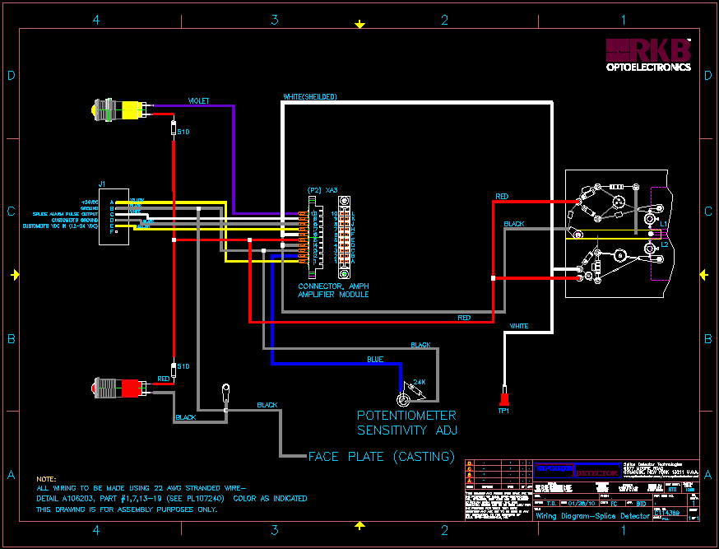
Features and Benefits
Patented in 1970 using H.V. as primary power source, The Model 1088 Sentinel® Splice Detector™ Technology has been redesigned to run off 24VDC. As a result, the unit consumes 50% less power and facilitates easier integration into many control devices worldwide.

Slide 8



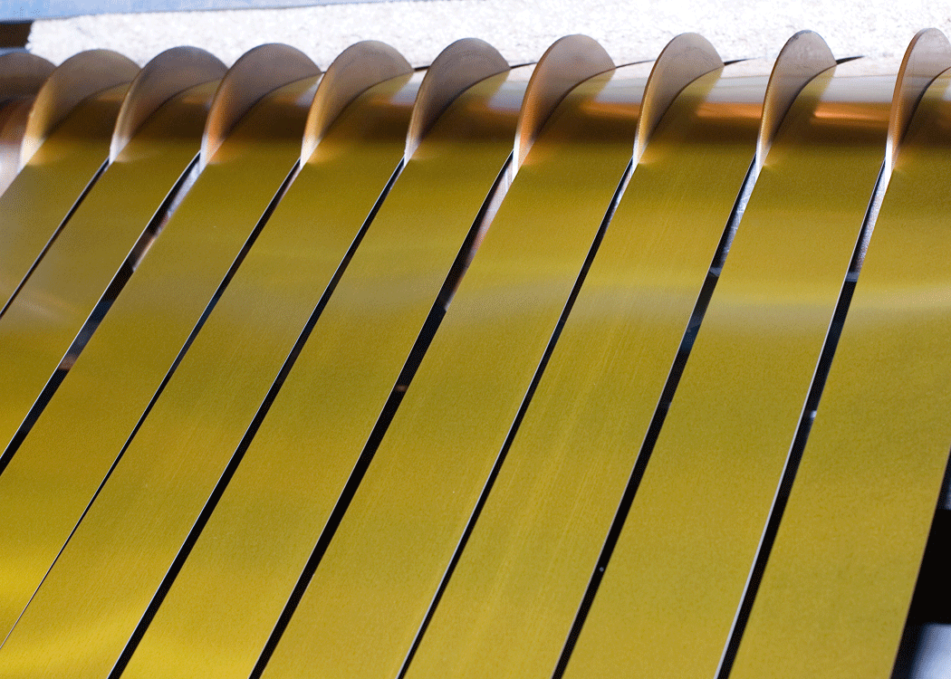
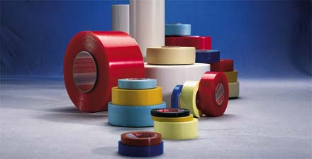



Features and Benefits
The Model 1088 Sentinel® Splice Detector™ Technology monitors any non-metallic web material including laminated grades.

Slide 9
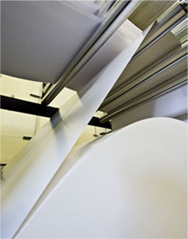
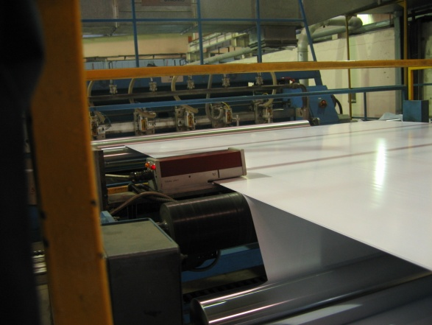
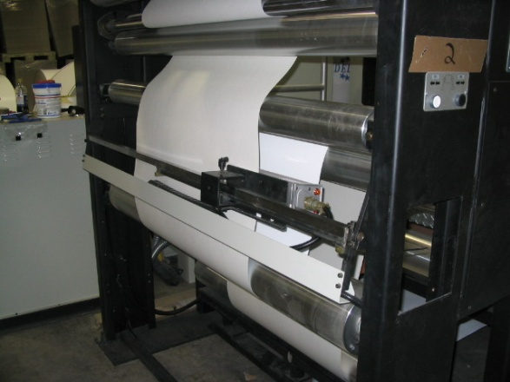
Features and Benefits
The Model 1088 Sentinel® Splice Detector™ Technology monitors single to multiple webs of material simultaneously at one inspection point.

Slide 10
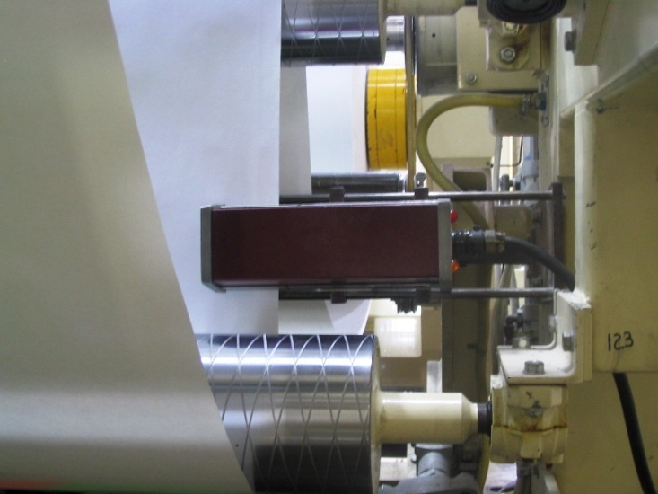
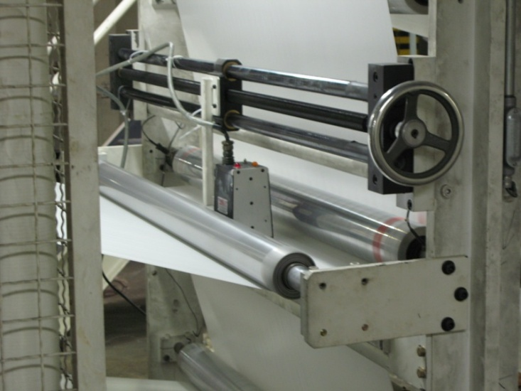
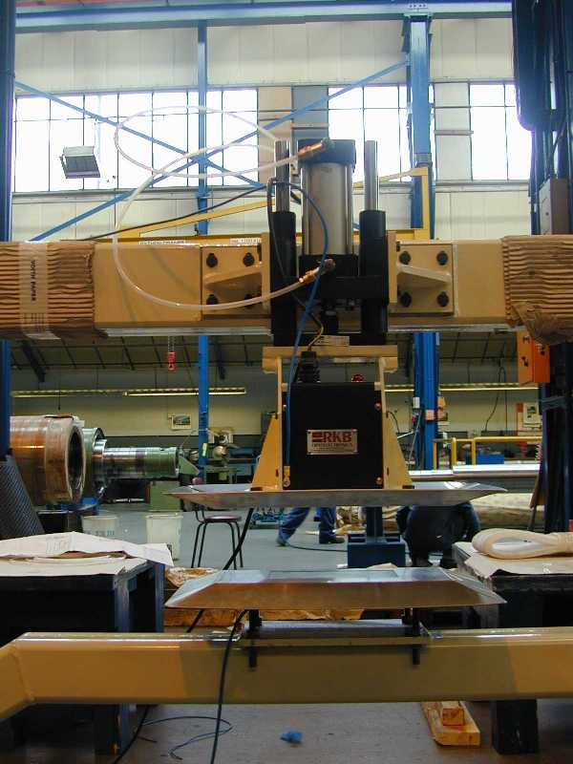
Features and Benefits
The Model 1088 Sentinel® Splice Detector™ Technology is unaffected by material basis weight changes, color or process speed (highest recorded installation @ 5000 fpm (1524 m/min).

Slide 11






Features and Benefits
The Model 1088 Sentinel® Splice Detector™ Technology is unaffected by printed material.

Slide 12
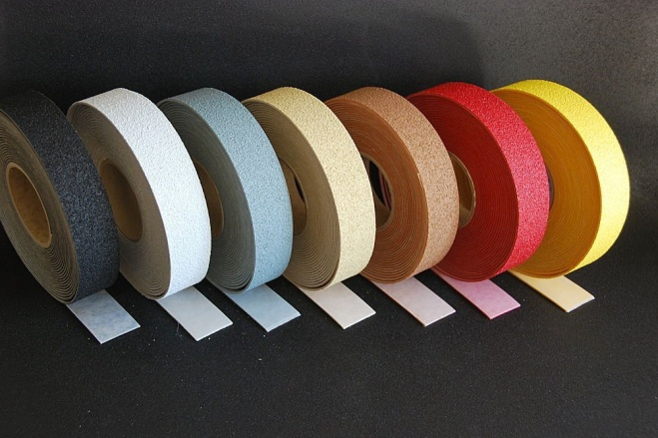
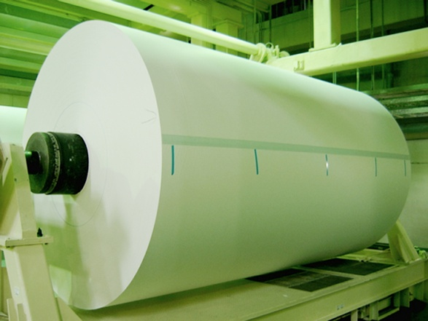

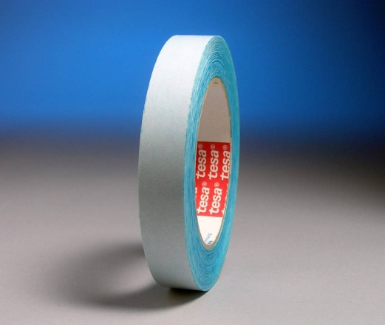
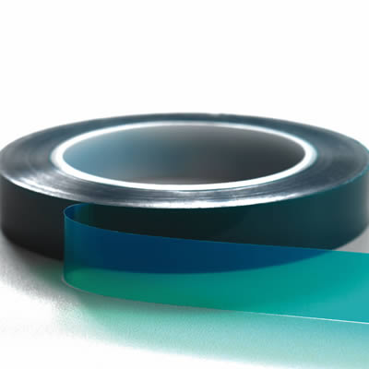
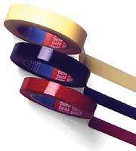
Features and Benefits
Special splice tapes or color marking are not required.

Slide 13
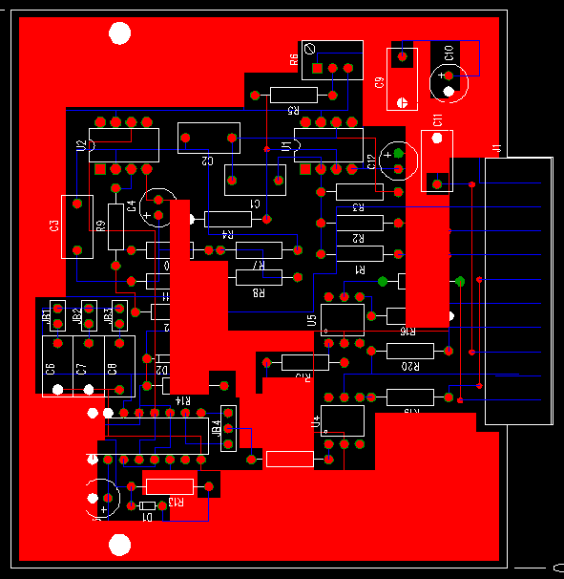
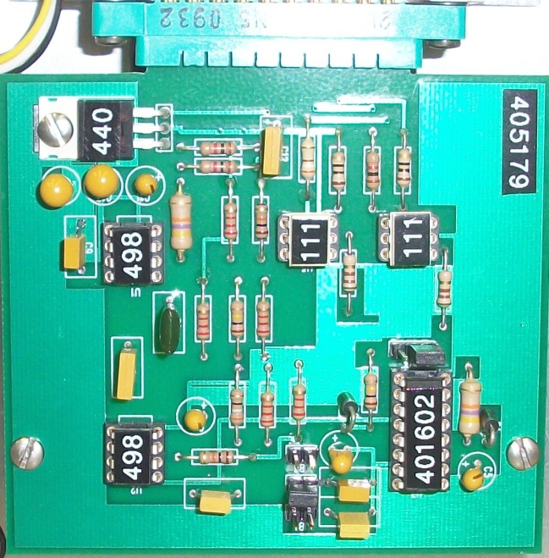
Features and Benefits
The Model 1088 Sentinel® Splice Detector™ Technology incorporates state-of-the-art electronic design circuitry, components, filtering and processing techniques unequaled in the industry. Opt-isolated 24VDC output with selectable 1, 10 or 100 millisecond time base.

Slide 14
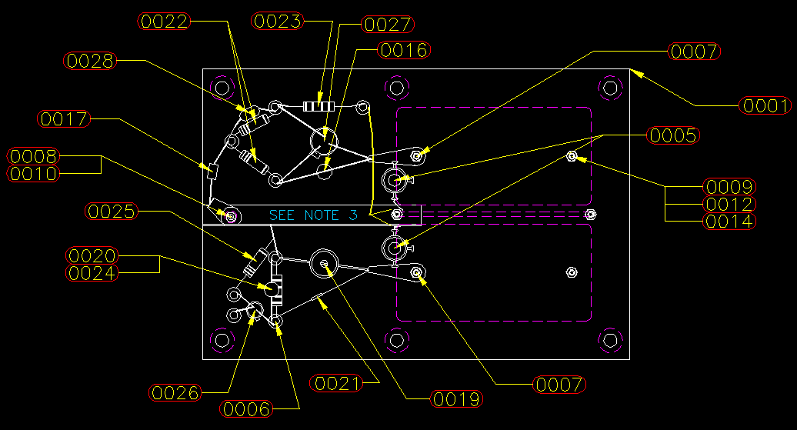
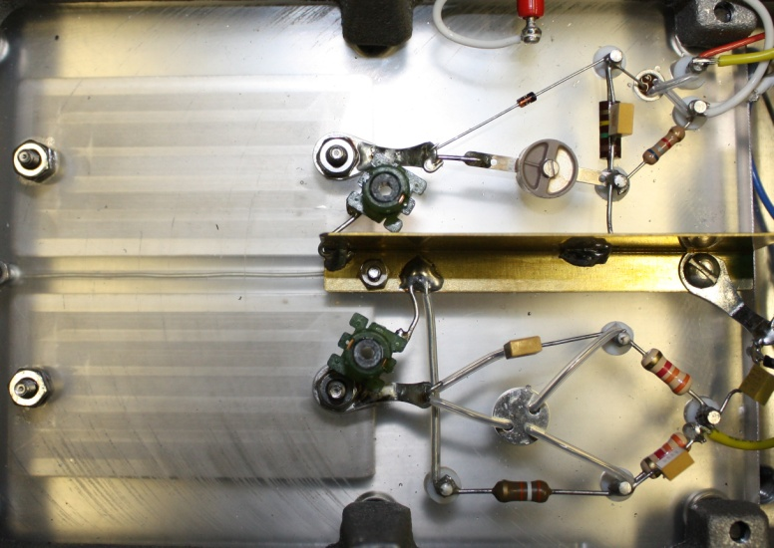
Features and Benefits
State-of-the-Art Proprietary Sensing Platform.

Slide 15
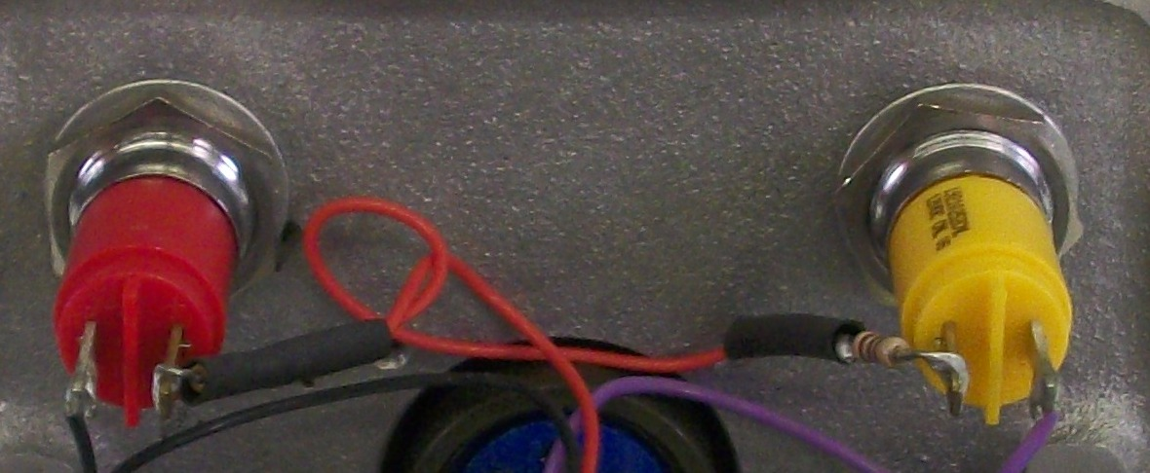
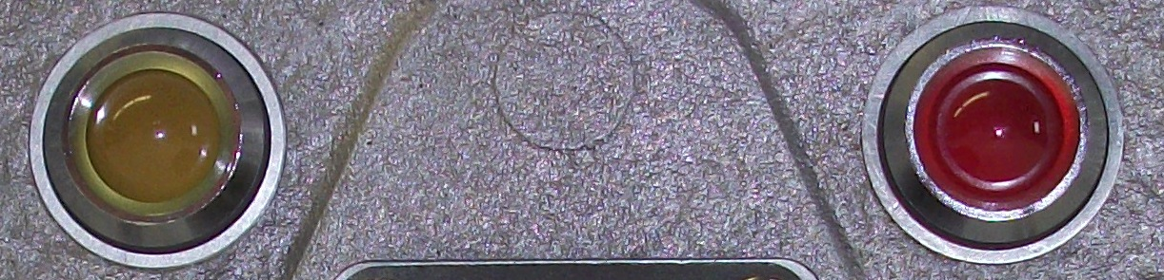
Features and Benefits
Highly visible LED’s and optional audio/visual alarms provide immediate alert to operational staff of critical splices. Provide user friendly outputs you can actually use too process control instrumentation.

Slide 16
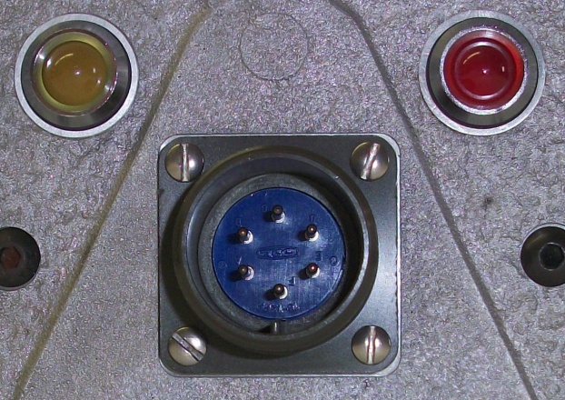
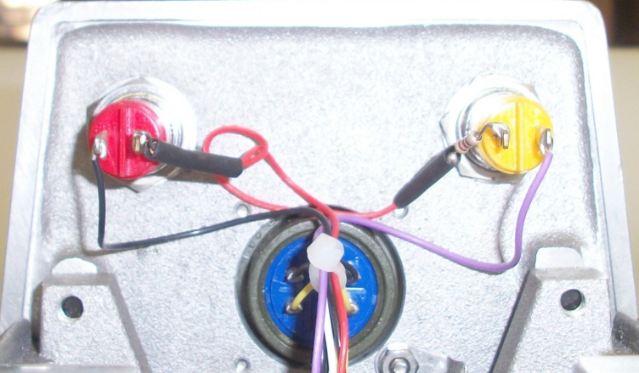
Features and Benefits
Military type connections ensure solid electrical specifications are maintained and environmental protection is achieved.

Slide 17
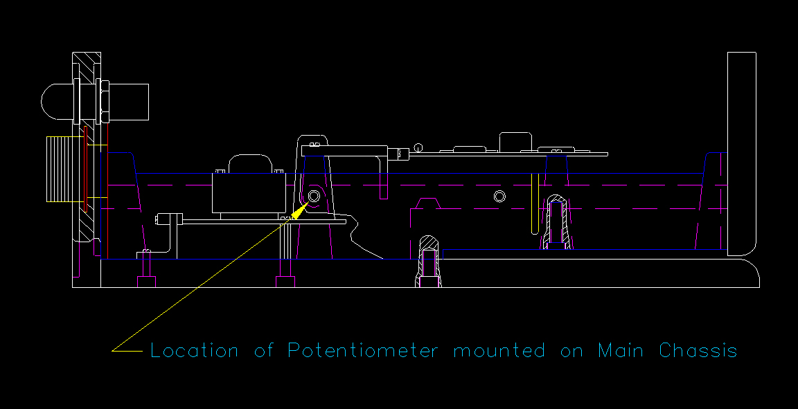
Features and Benefits
Automatic recalibration on product grade changes.

Slide 18
Features and Benefits
Meets quality initiative and ISO requirements.
Detection 24/7 without the need for operational intervention.
Eliminate the need for manual inspections.
100% detection of “ALL” splices, Guaranteed!
CE, CCC and RoHS Compliant

Slide 19
Applications
Sheeters
Wide Format Printing
Roto
Laminators
Slitters
Coaters
Non-wovens

Slide 20
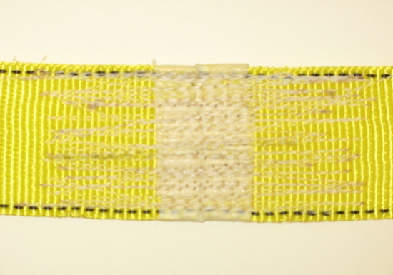
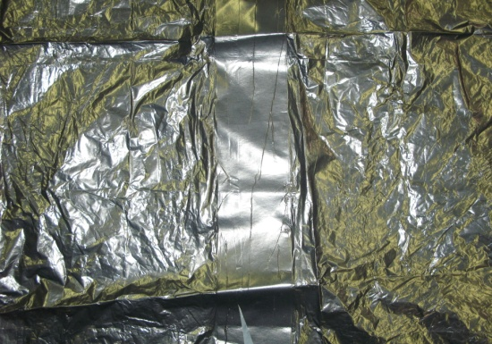


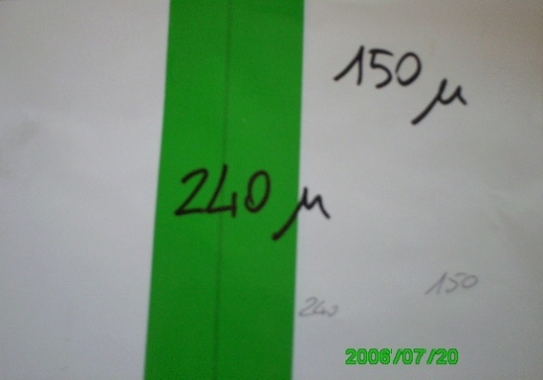

Detection Results
The result is the detection of any splice type (overlap, butt, special) and any splice (tape, staples, woven, glue, etc.).

Slide 21
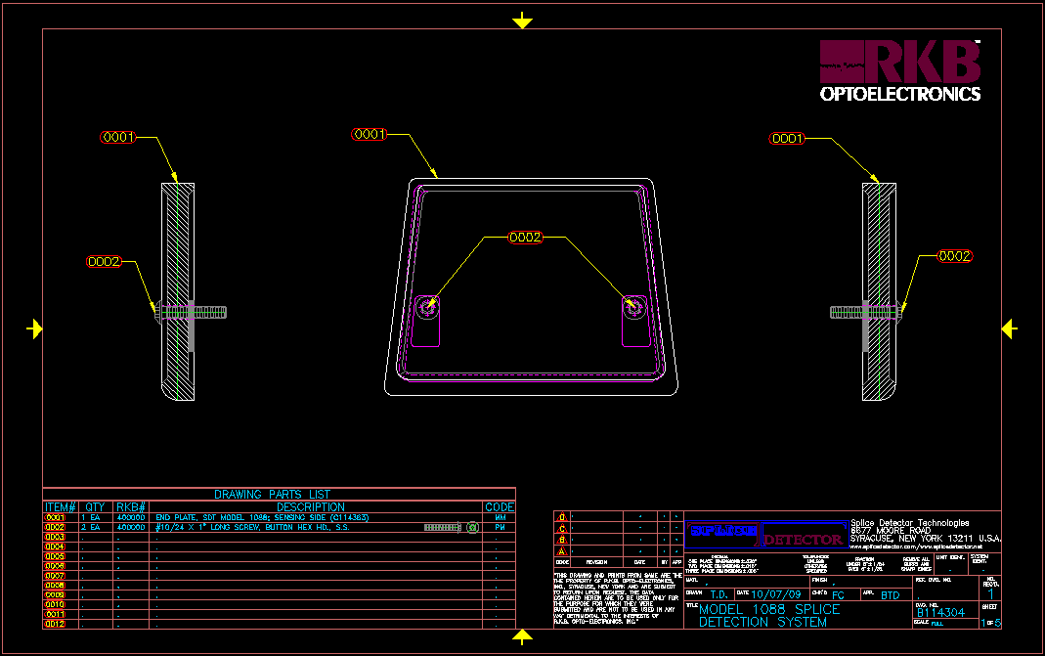
Approval Drawing

Slide 22
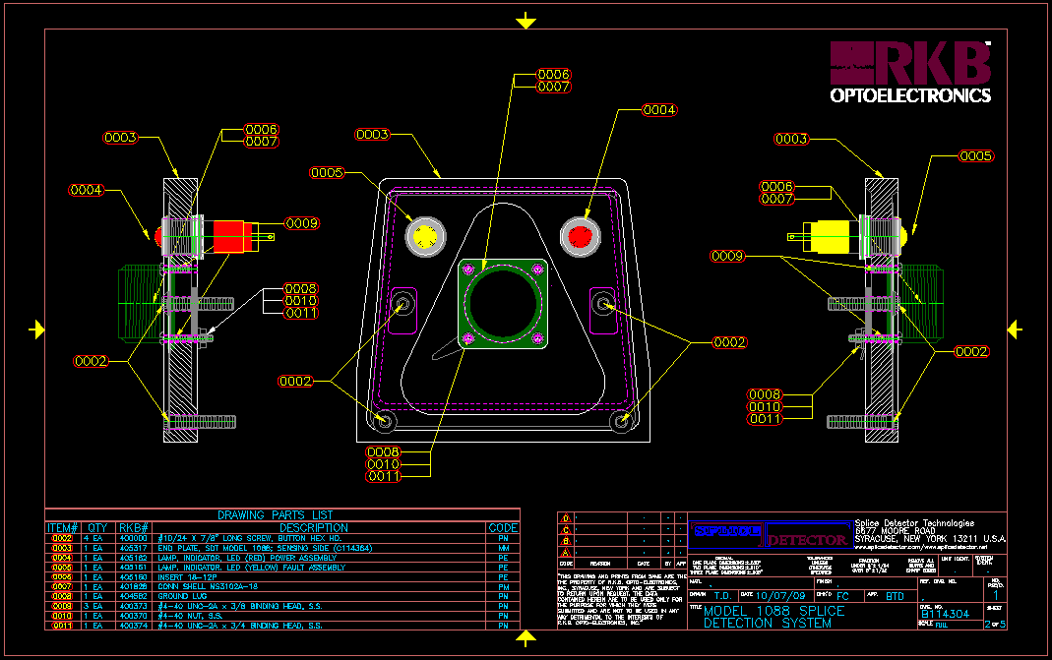
Approval Drawing

Slide 23
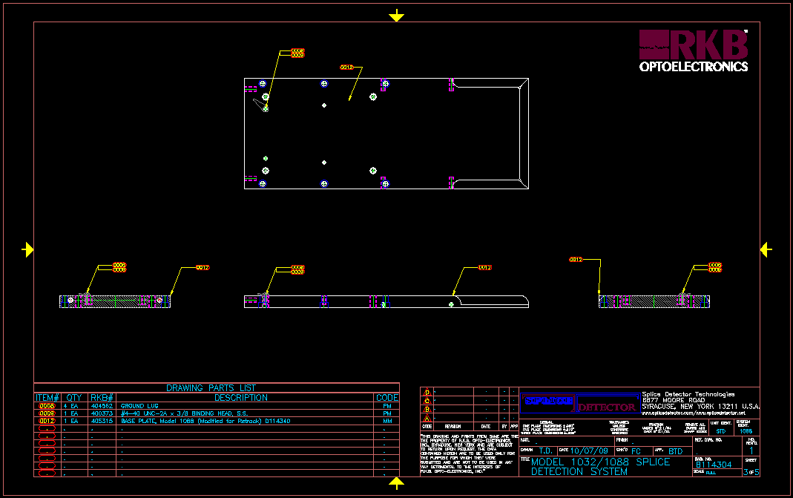
Approval Drawing

Slide 24
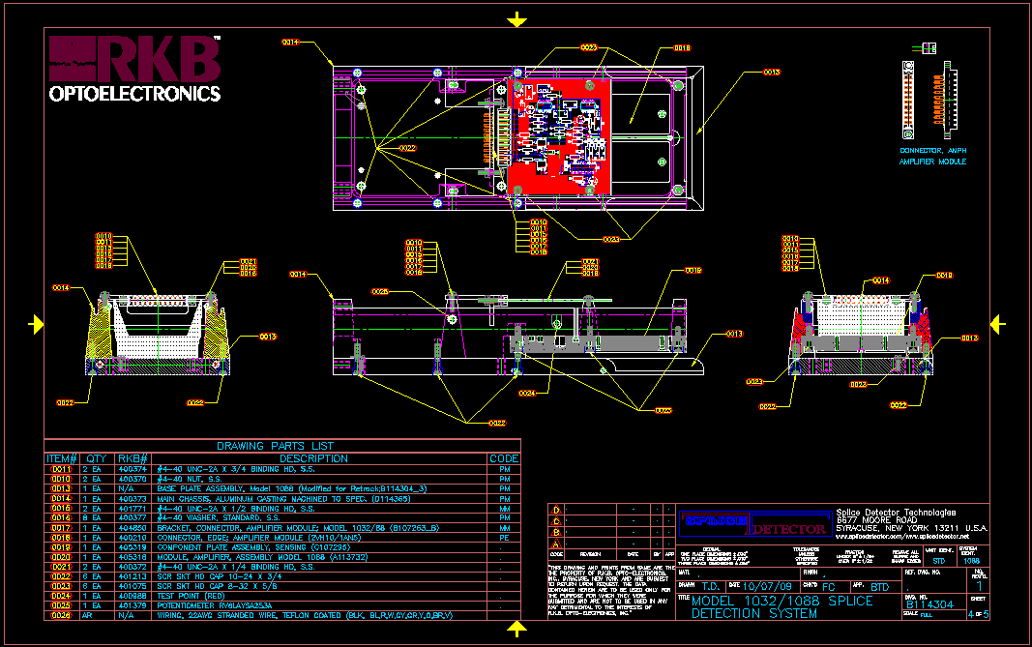
Approval Drawing

Slide 25
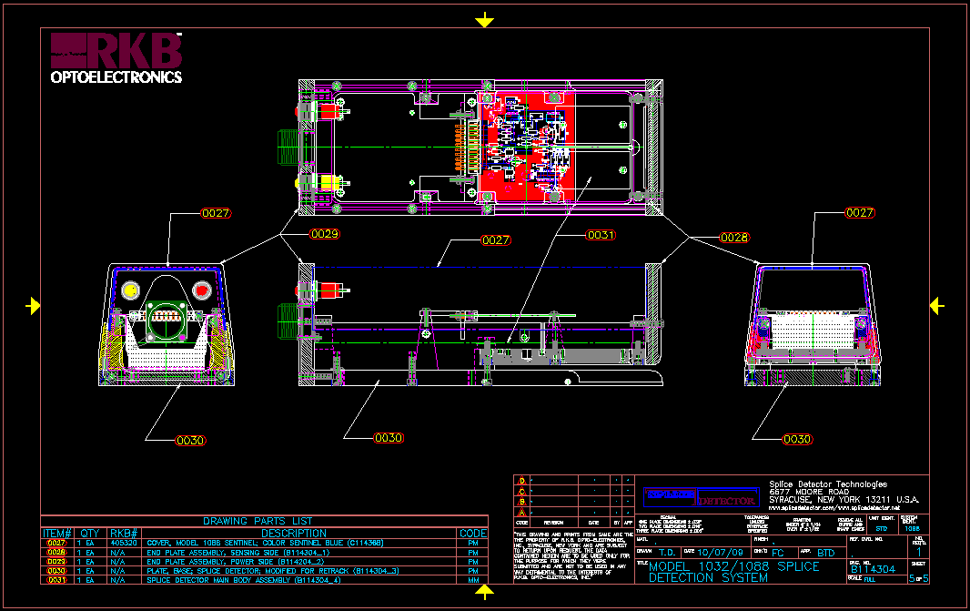
Approval Drawing

Slide 26
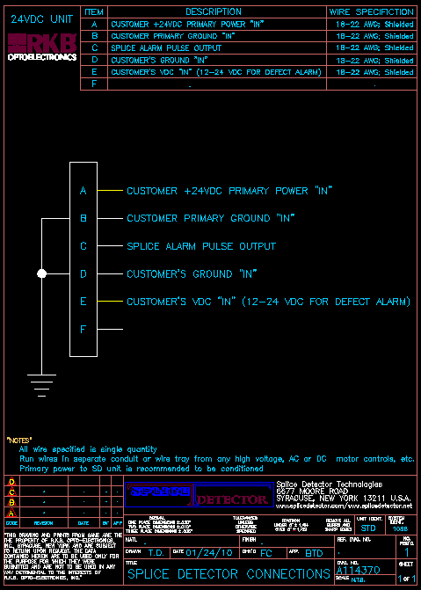
Power Requirements

Slide 27
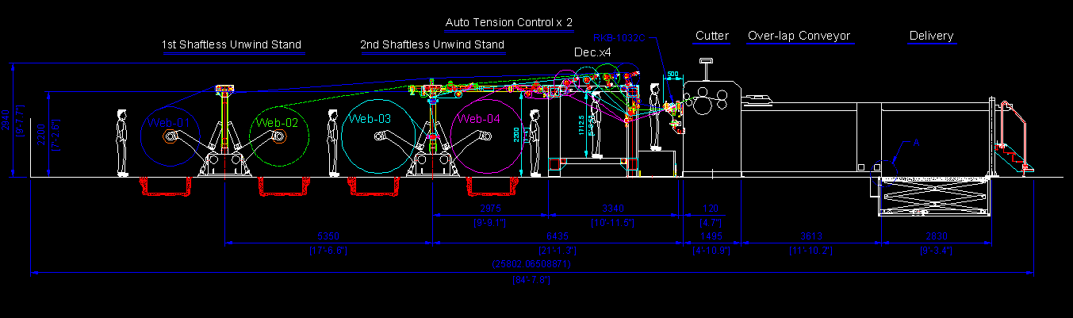
Typical Installation

Slide 28
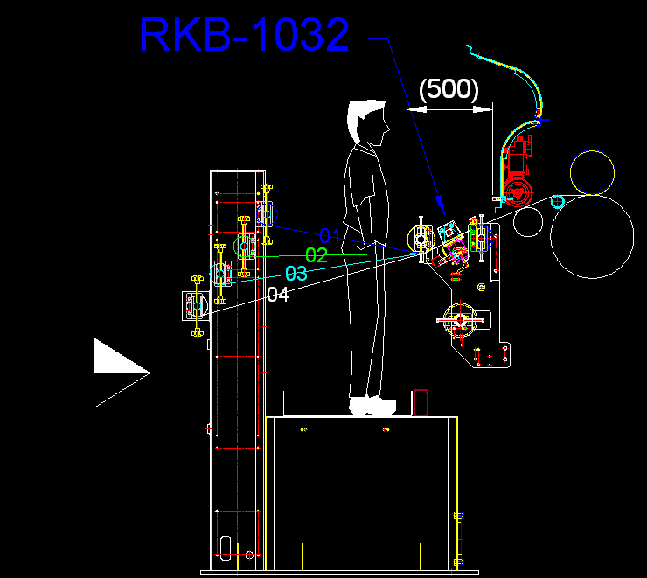
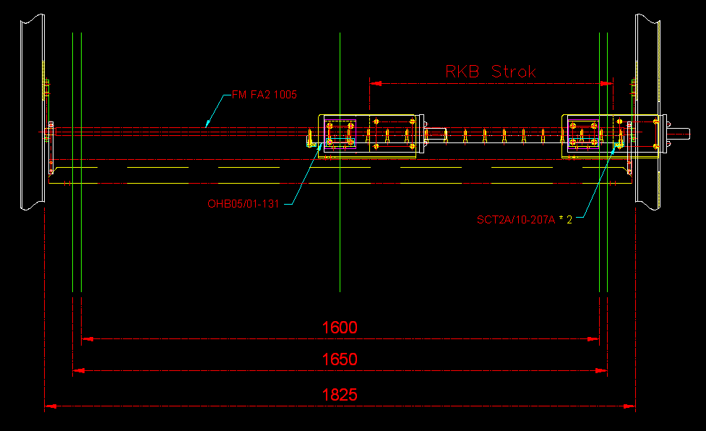
Typical Installation

Slide 29
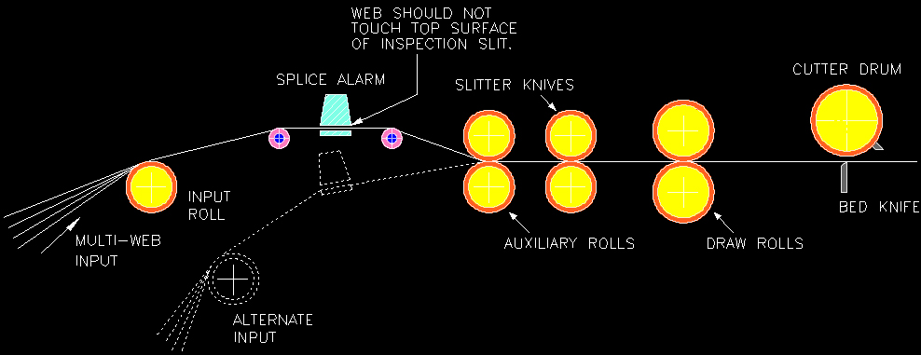
Typical Installation

Slide 30
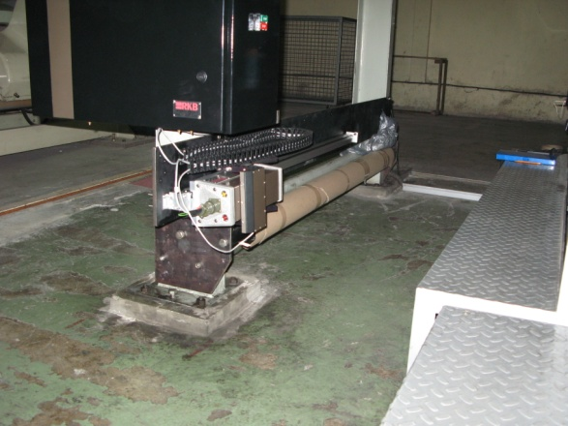
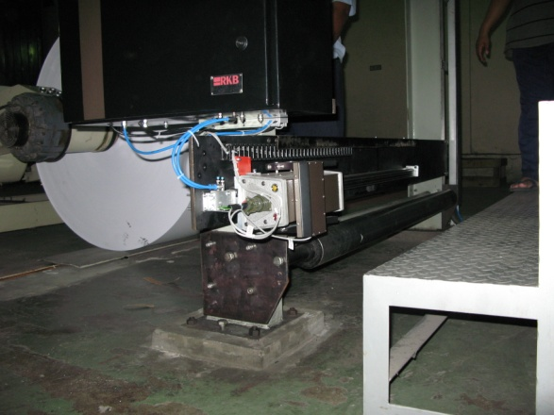
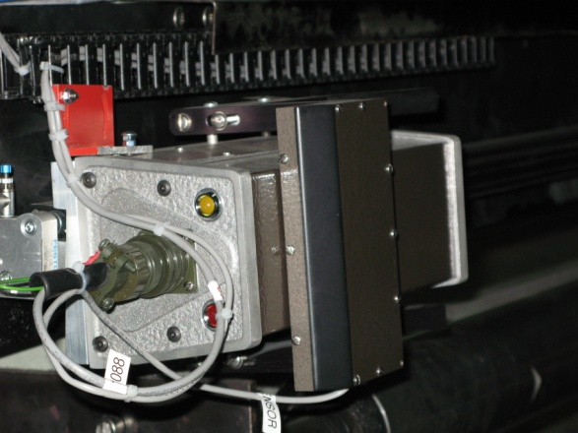
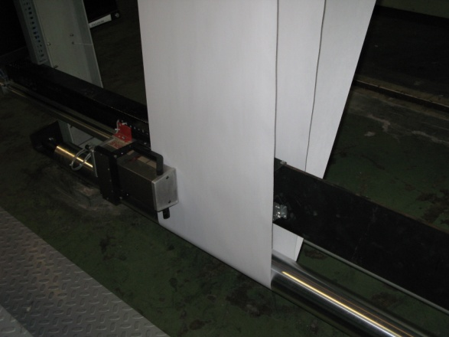
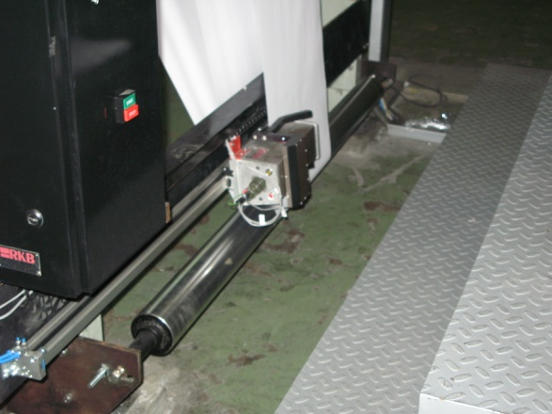
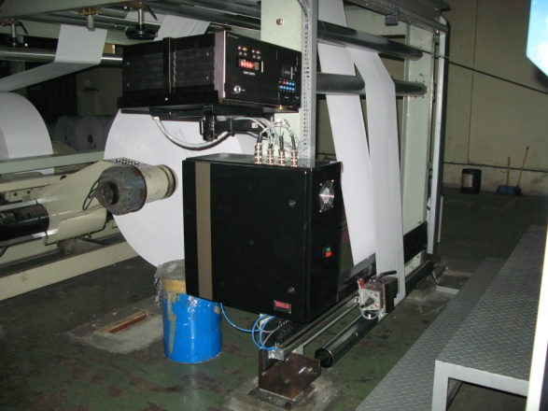
Installation at Major Paper Maker

Slide 31

References
For reliability; large, medium and small companies turn to RKB for their splice (joint) detection needs.

Slide 32
Related Websites
R.K.B. OPTO-ELECTRONICS, INC., Syracuse, New York, United States
http://www.rkbopto.com
R.K.B. Europe, Santander (SPAIN)
http://rkbdetector.com/
Arkia Industrial, Sao Paulo, Brasil
http://www.arkia.com.br
FIOCCHI Process Instrumentation, Milan, Italy
http://www. fioproin.it
Grupo ROSA Automatización y Control S.A. de C.V., Chihuahua, Mexico
http://gruporosa.com.mx/
PT. Pentraco Karya Adiprestasi, Jakarta Barat, Indonesia
http://www.pentraco.com/
Quality2Process B.V., Hengelo, The Netherlands
http://www.quality2process.com
Splice Detector Technologies, Syracuse, New York, United States
http://www.splicedetector.net / www.hole-detection.com / www.webinspection.us / www.splicedetector.com
Suzhou Machine Vision Co., Ltd., Suzhou, Jiangsu, China
http://rkb.chinapaper.net
Swallow Machinery Co., Ltd., Meltham, Holmfirth, United Kingdom
http://www.swallowmachinery.com

