Slide 1
System Overview
Model 1032BM Black Mamba® Web Press Splice Detector™ & Distribution Technology
Bruce T. Dobbie
Copyright© R.K.B. OPTO-ELECTRONICS, INC. All rights reserved.

Slide 2
Mission Statement
Splice Detector Technologies is a designer and manufacturer of high speed splice, tearout, missing ply and web break detection equipment and related products. We are committed to the industry and our customers that depend on us to ensure that quality is maintained at the highest possible level. We are dedicated to increasing customer satisfaction, continuously improving our products and services, and providing opportunities for our employees to achieve their maximum potential.

Slide 3
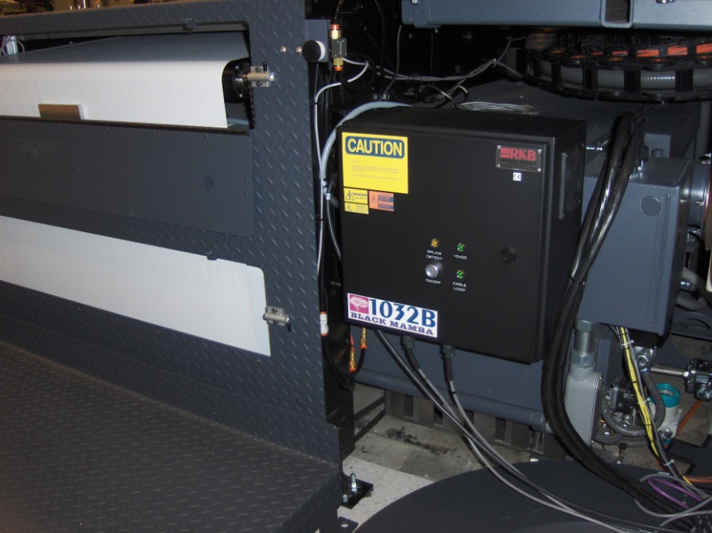
Model 1032BM Black Mamba® Web Press Splice Detector™ & Distribution Technology
FOR MORE INFO...
http://www.splicedetector.net/splicedetector_products/web_press_splice_detector_technology_1032.html
http://www.splicedetector.com/splicedetector_products/m1032bm_web_press_splicedetector.html

Slide 4
Technology

Slide 5
Overview of Benefits
The Model 1032BM Black Mamba® Web Press Splice Detector™ & Distribution Technology is designed to be implemented on high speed digital and inkjet web presses for the detection splice defects and distribution of subsequent even fault signals to raise/release print heads or stations to allow the passage of that portion of defective paper. By facilitating this function, the Model 1032BM Black Mamba® insures that no damage to sensitive print heads are realized preventing costly damage and down time. The technology also comes with distribution to third party sheeting options that can be employed at the end of the web press to allow automatic rejection of the defective sheet thus preventing it from passage to quality stacked products. This technology also allows end users to purchase standard rolls of paper at costs much less than the marketed “Splice Free Paper” required of them currently.

Slide 6
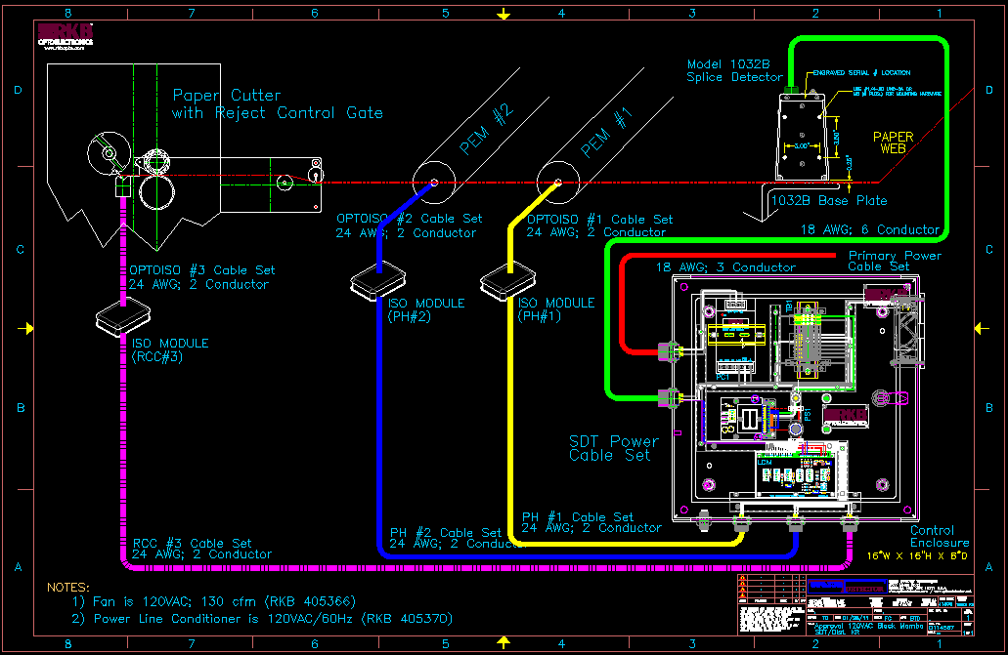
Features and Benefits
Every Model 1032BM Black Mamba® is handcrafted to specific standards which facilitates inter-changeability and performance.

Slide 7
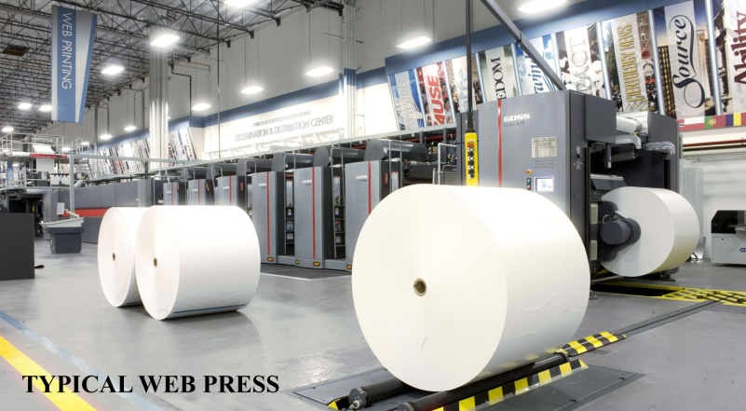
Features and Benefits
The Model 1032BM Black Mamba® has become the leading splice (joint) detection system used worldwide in web press processes. While run off of 120/220VAC; 50/60Hz; Single Phase, this unit can be implemented anywhere in the world and provides three digital outputs each to independent print stations and an option reject gate control station as well as a dry contact relay rated at 3 amps. This unit is truly plug and play and can be easily integrated into web presses commonly found in the printing industry.

Slide 8
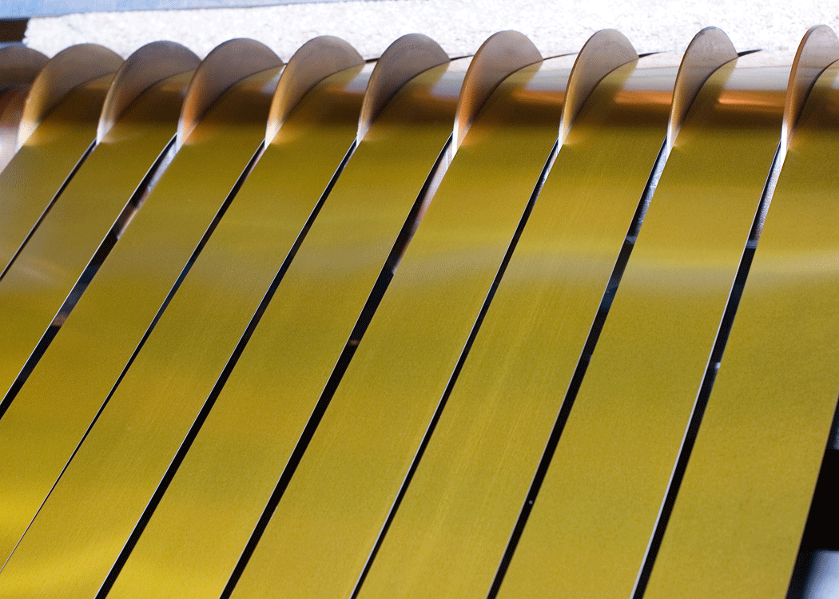
Features and Benefits
The Model 1032BM Black Mamba® monitors any non-metallic web material including laminated grades.

Slide 9
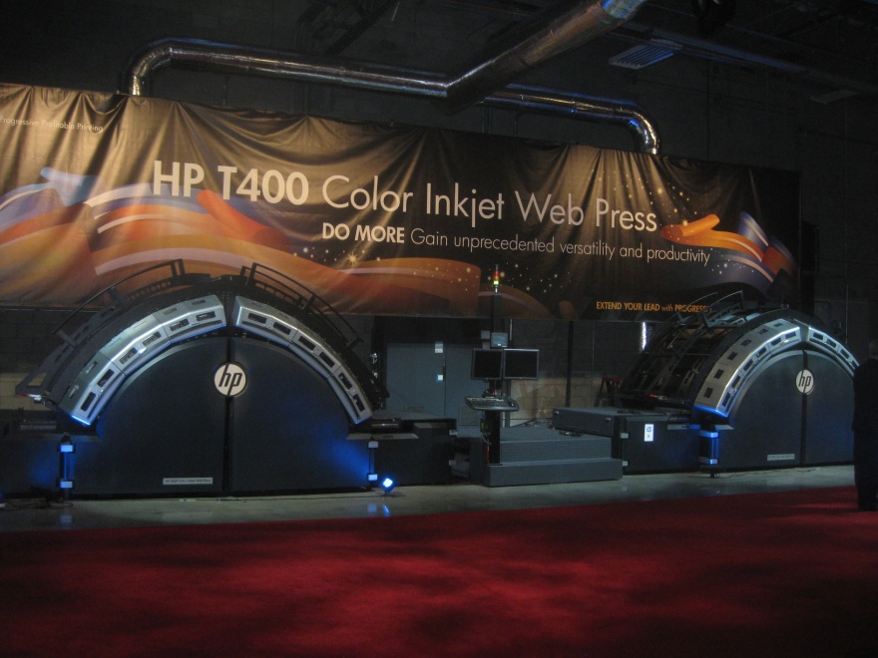
Features and Benefits
The Model 1032BM Black Mamba® monitors the web material to be printed for splices and provides the signaling to retract sensitive print heads preventing damage.

Slide 10
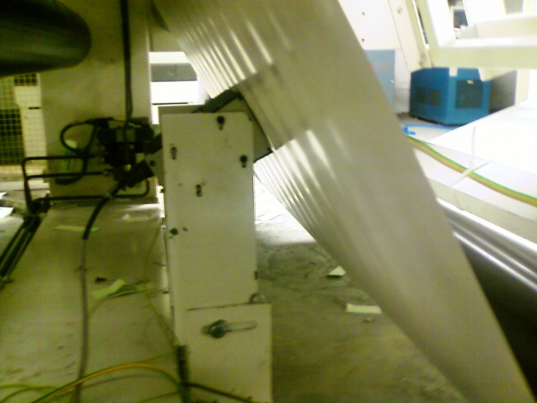
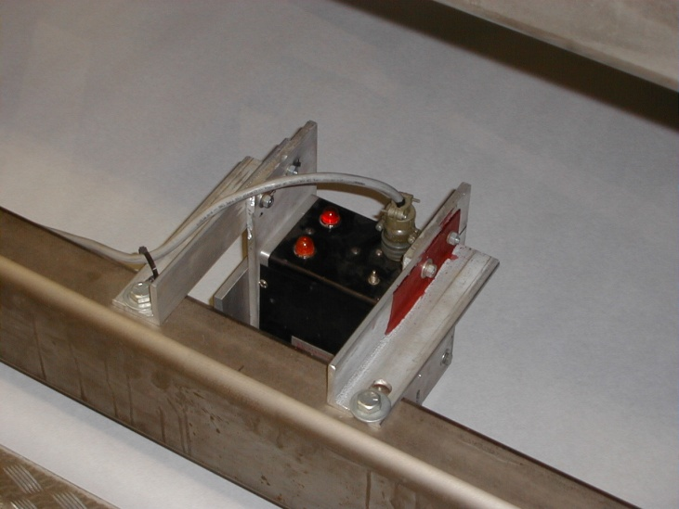
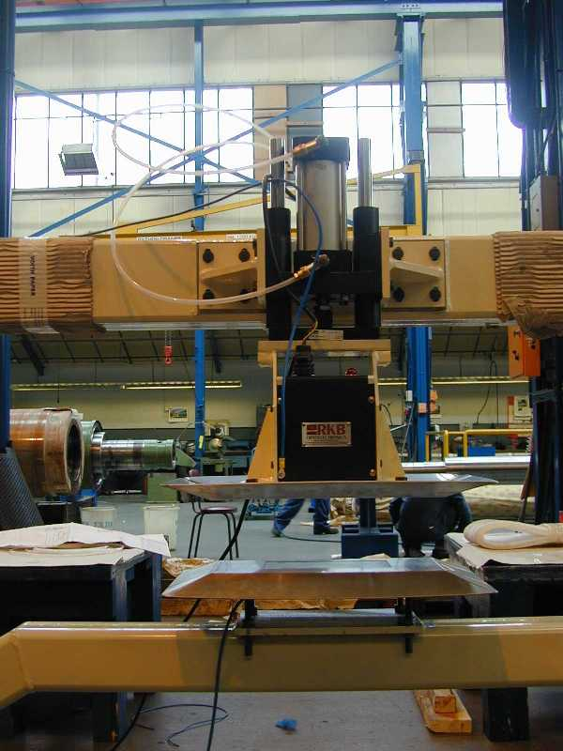
Features and Benefits
The Model 1032BM Black Mamba® is unaffected by material basis weight changes, color or process speed (highest recorded installation @ 5000 fpm (1524 m/min).

Slide 11
Features and Benefits
The Model 1032BM Black Mamba® is unaffected by printed material.

Slide 12
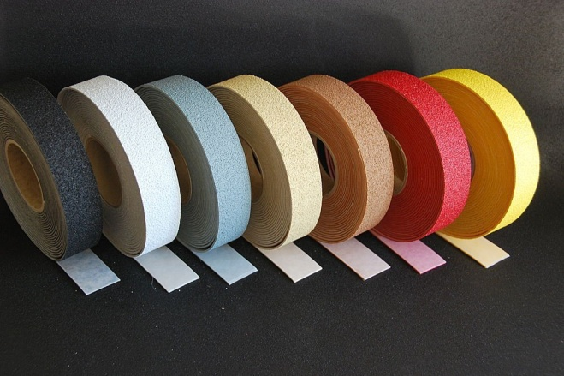
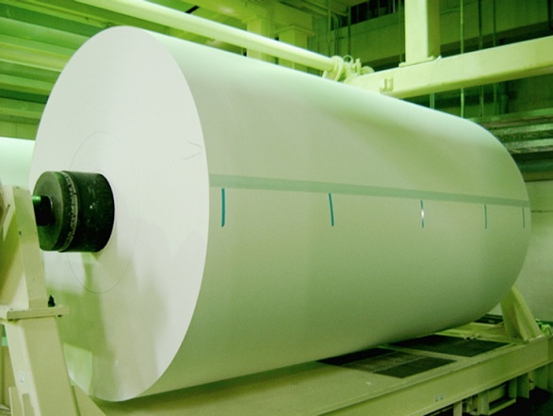
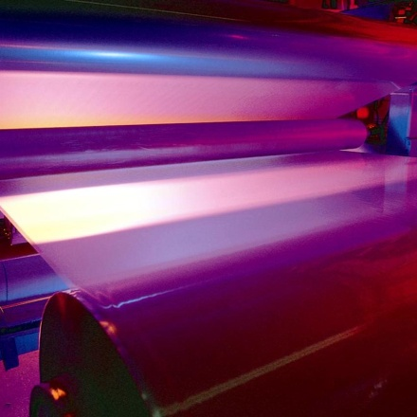
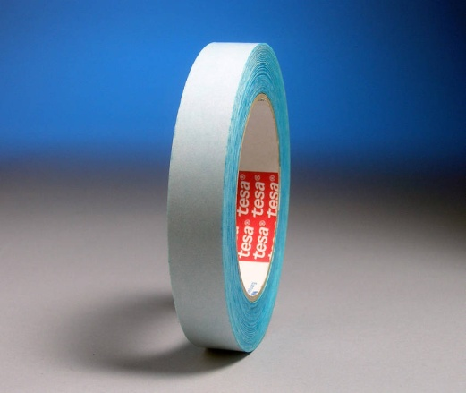
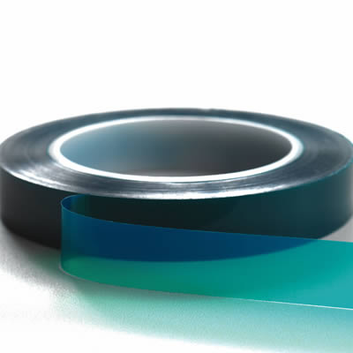
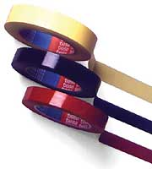
Features and Benefits
Special splice tapes or color marking are not required.

Slide 13
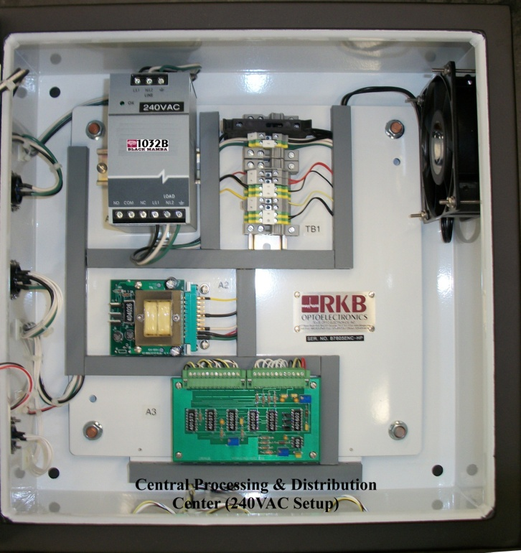
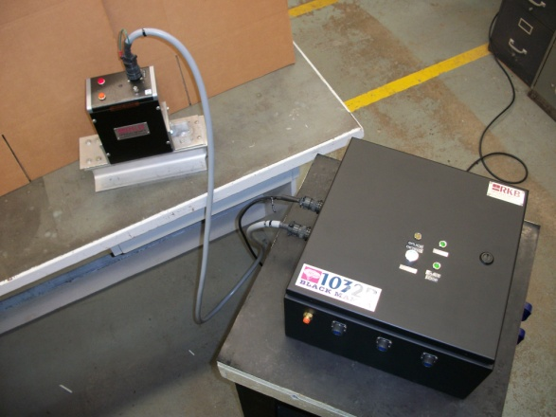
Features and Benefits
The Model 1032BM Black Mamba® incorporates state-of-the-art electronic design circuitry, components, filtering and processing techniques unequaled in the industry. A 15 VDC digital pulse and dry contact relay is provided for operational interface to control devices, markers, or taggers.

Slide 14
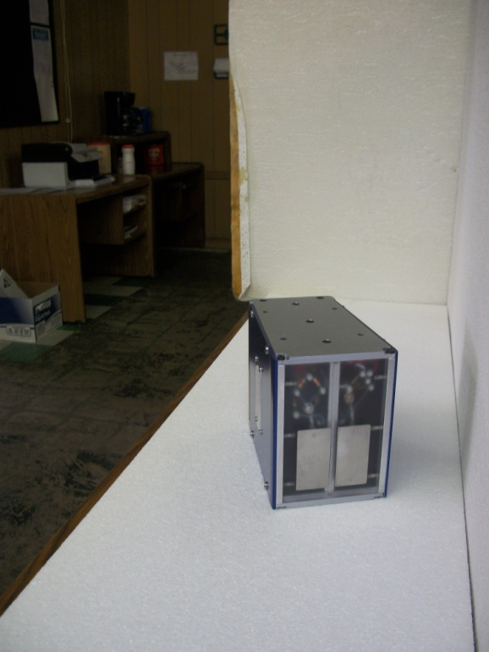
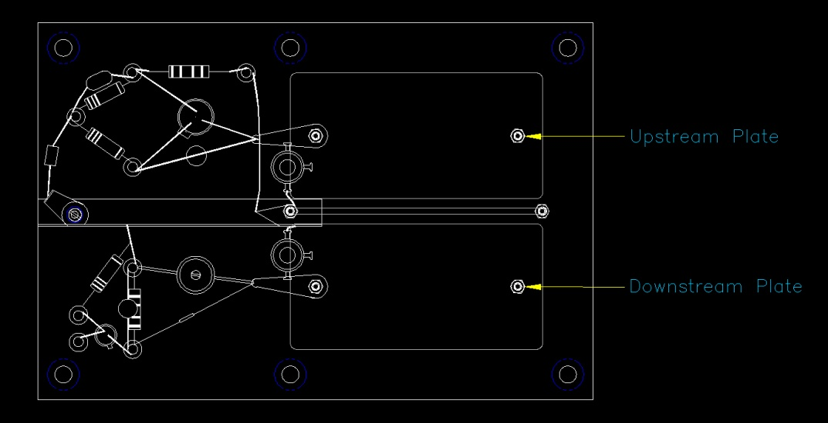
Features and Benefits
State-of-the-Art Proprietary Sensing Platform.

Slide 15
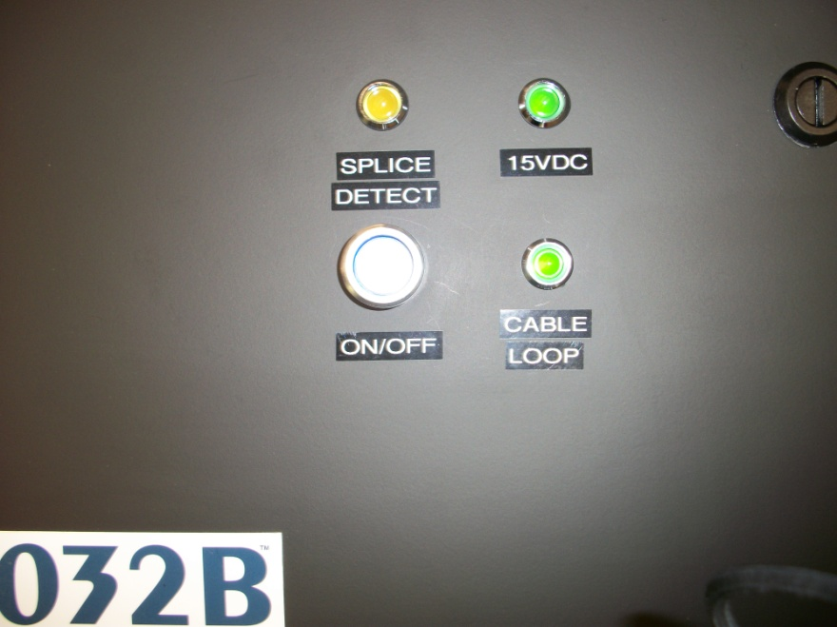
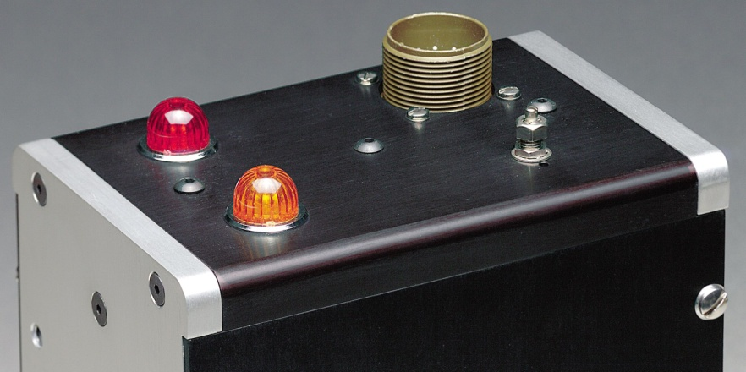
Features and Benefits
Highly visible indicator lamps and optional audio/visual alarms provide immediate alert to operational staff of critical splices. Provide user friendly outputs you can actually use too process control instrumentation.

Slide 16
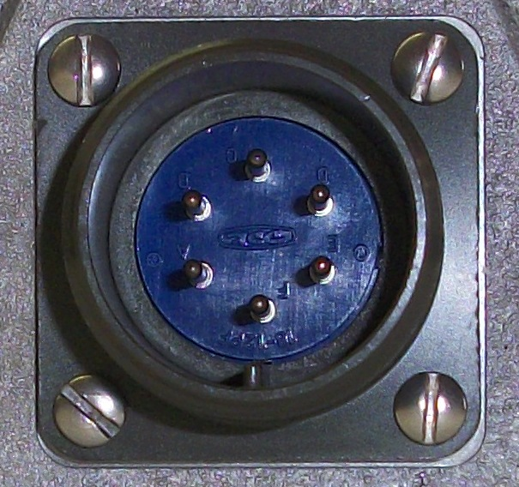
Features and Benefits
Military type connections ensure solid electrical specifications are maintained and environmental protection is achieved.

Slide 17
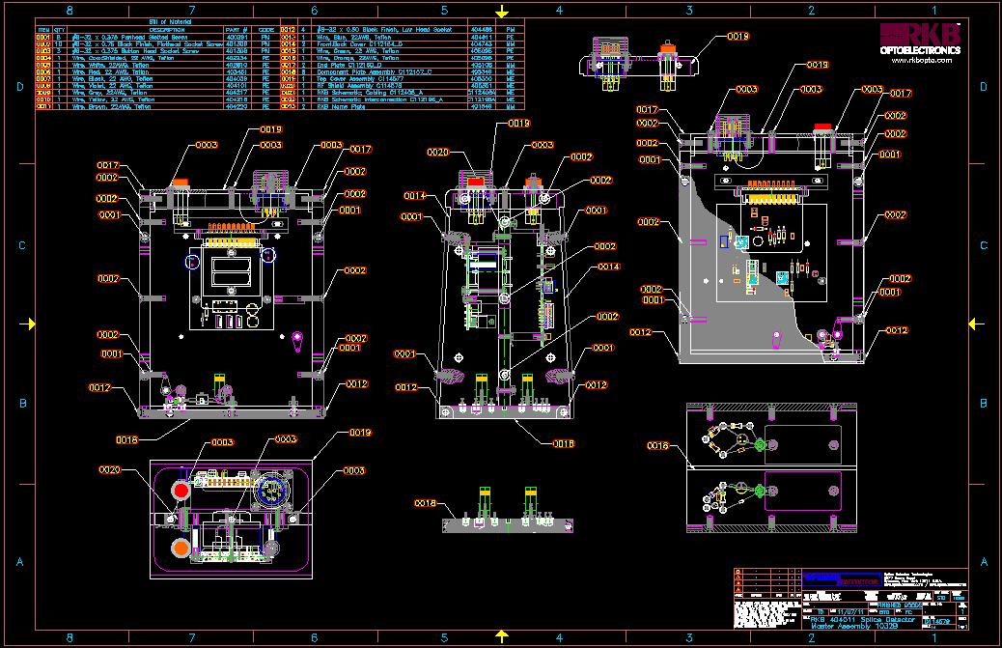
Features and Benefits
Automatic recalibration on product grade changes. No operational intervention is required.

Slide 18
Features and Benefits
Meets quality initiative and ISO requirements.
Detection 24/7 without the need for operational intervention.
Eliminate the need for manual inspections.
Detection of “ALL” splices, Guaranteed!
CE, CCC and RoHS Complaint

Slide 19
Applications
High Speed Web Press Printing

Slide 20
Detection Results
The result is the detection of any splice type (overlap, butt, special) and any splice (tape, staples, woven, glue, etc.).

Slide 21
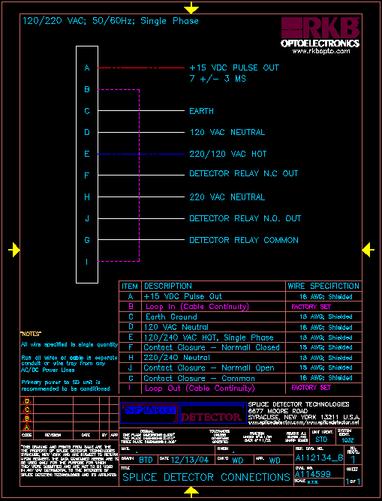
Power Requirements

Slide 22
Typical Installation

Slide 23
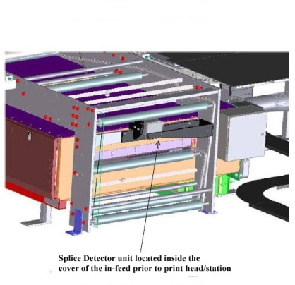
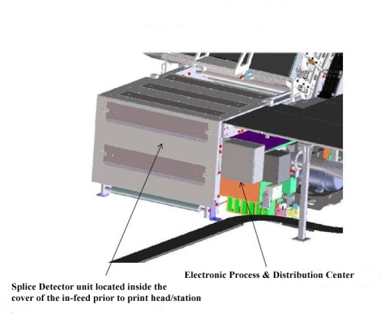
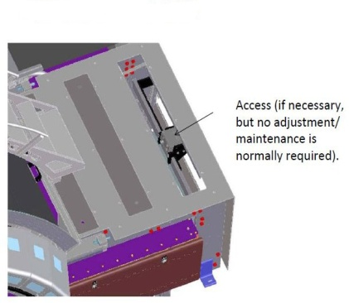
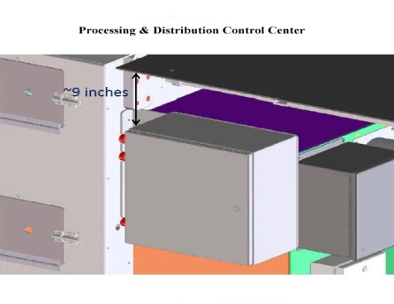
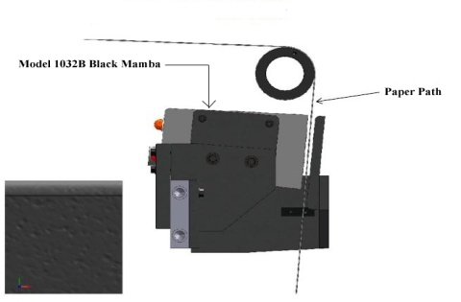
Typical Installation

Slide 24
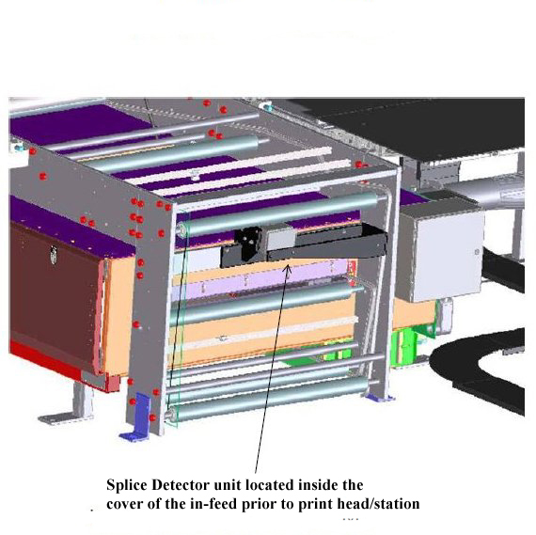
Typical Installation

Slide 25
Installation on major web press

Slide 26
References
For reliability; large, medium and small companies turn to RKB for their splice (joint) detection needs.

Slide 27
Related Websites
R.K.B. OPTO-ELECTRONICS, INC., Syracuse, New York, United States
http://www.rkbopto.com
R.K.B. Europe, Santander (SPAIN)
http://rkbdetector.com/
Arkia Industrial, Sao Paulo, Brasil
http://www.arkia.com.br
FIOCCHI Process Instrumentation, Milan, Italy
http://www. fioproin.it
Grupo ROSA Automatización y Control S.A. de C.V., Chihuahua, Mexico
http://gruporosa.com.mx/
PT. Pentraco Karya Adiprestasi, Jakarta Barat, Indonesia
http://www.pentraco.com/
Quality2Process B.V., Hengelo, The Netherlands
http://www.quality2process.com
Splice Detector Technologies, Syracuse, New York, United States
http://www.splicedetector.net / www.hole-detection.com / www.webinspection.us / www.splicedetector.com
Suzhou Machine Vision Co., Ltd., Suzhou, Jiangsu, China
http://rkb.chinapaper.net
Swallow Machinery Co., Ltd., Meltham, Holmfirth, United Kingdom
http://www.swallowmachinery.com

